Slide 1
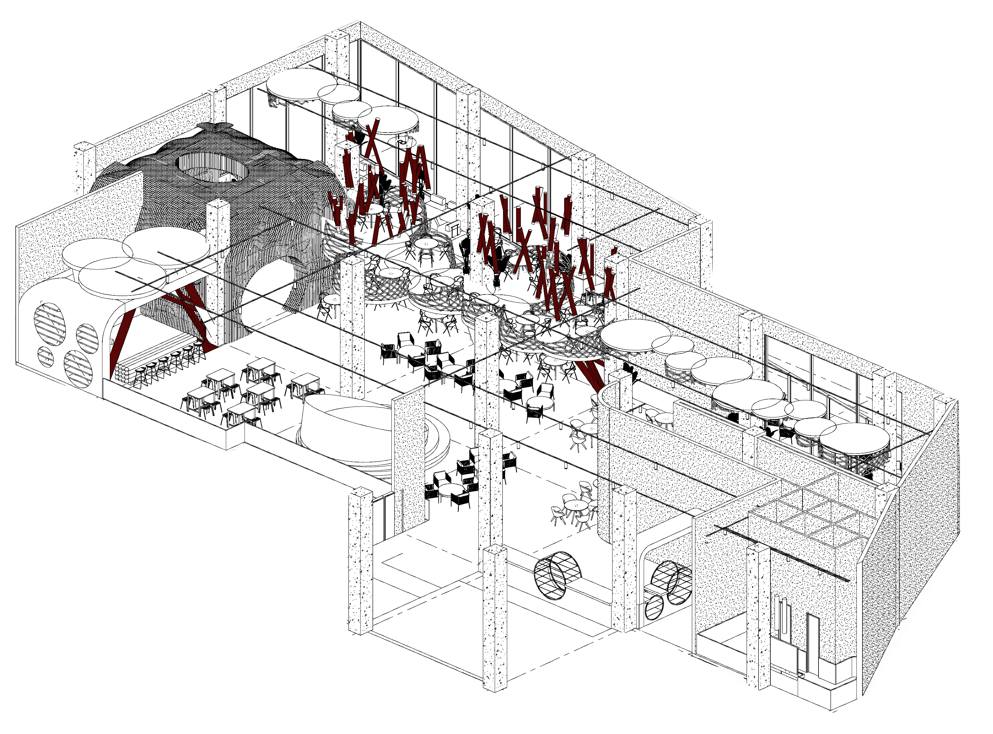
Cavo restaurant PROJECT
PROF:
ENG REZA MAFAKHER
DESIGN GROUP:
FATEME KHODADOUSTAN
FAEZE YAVARI
POUYA HABIBI

Slide 2
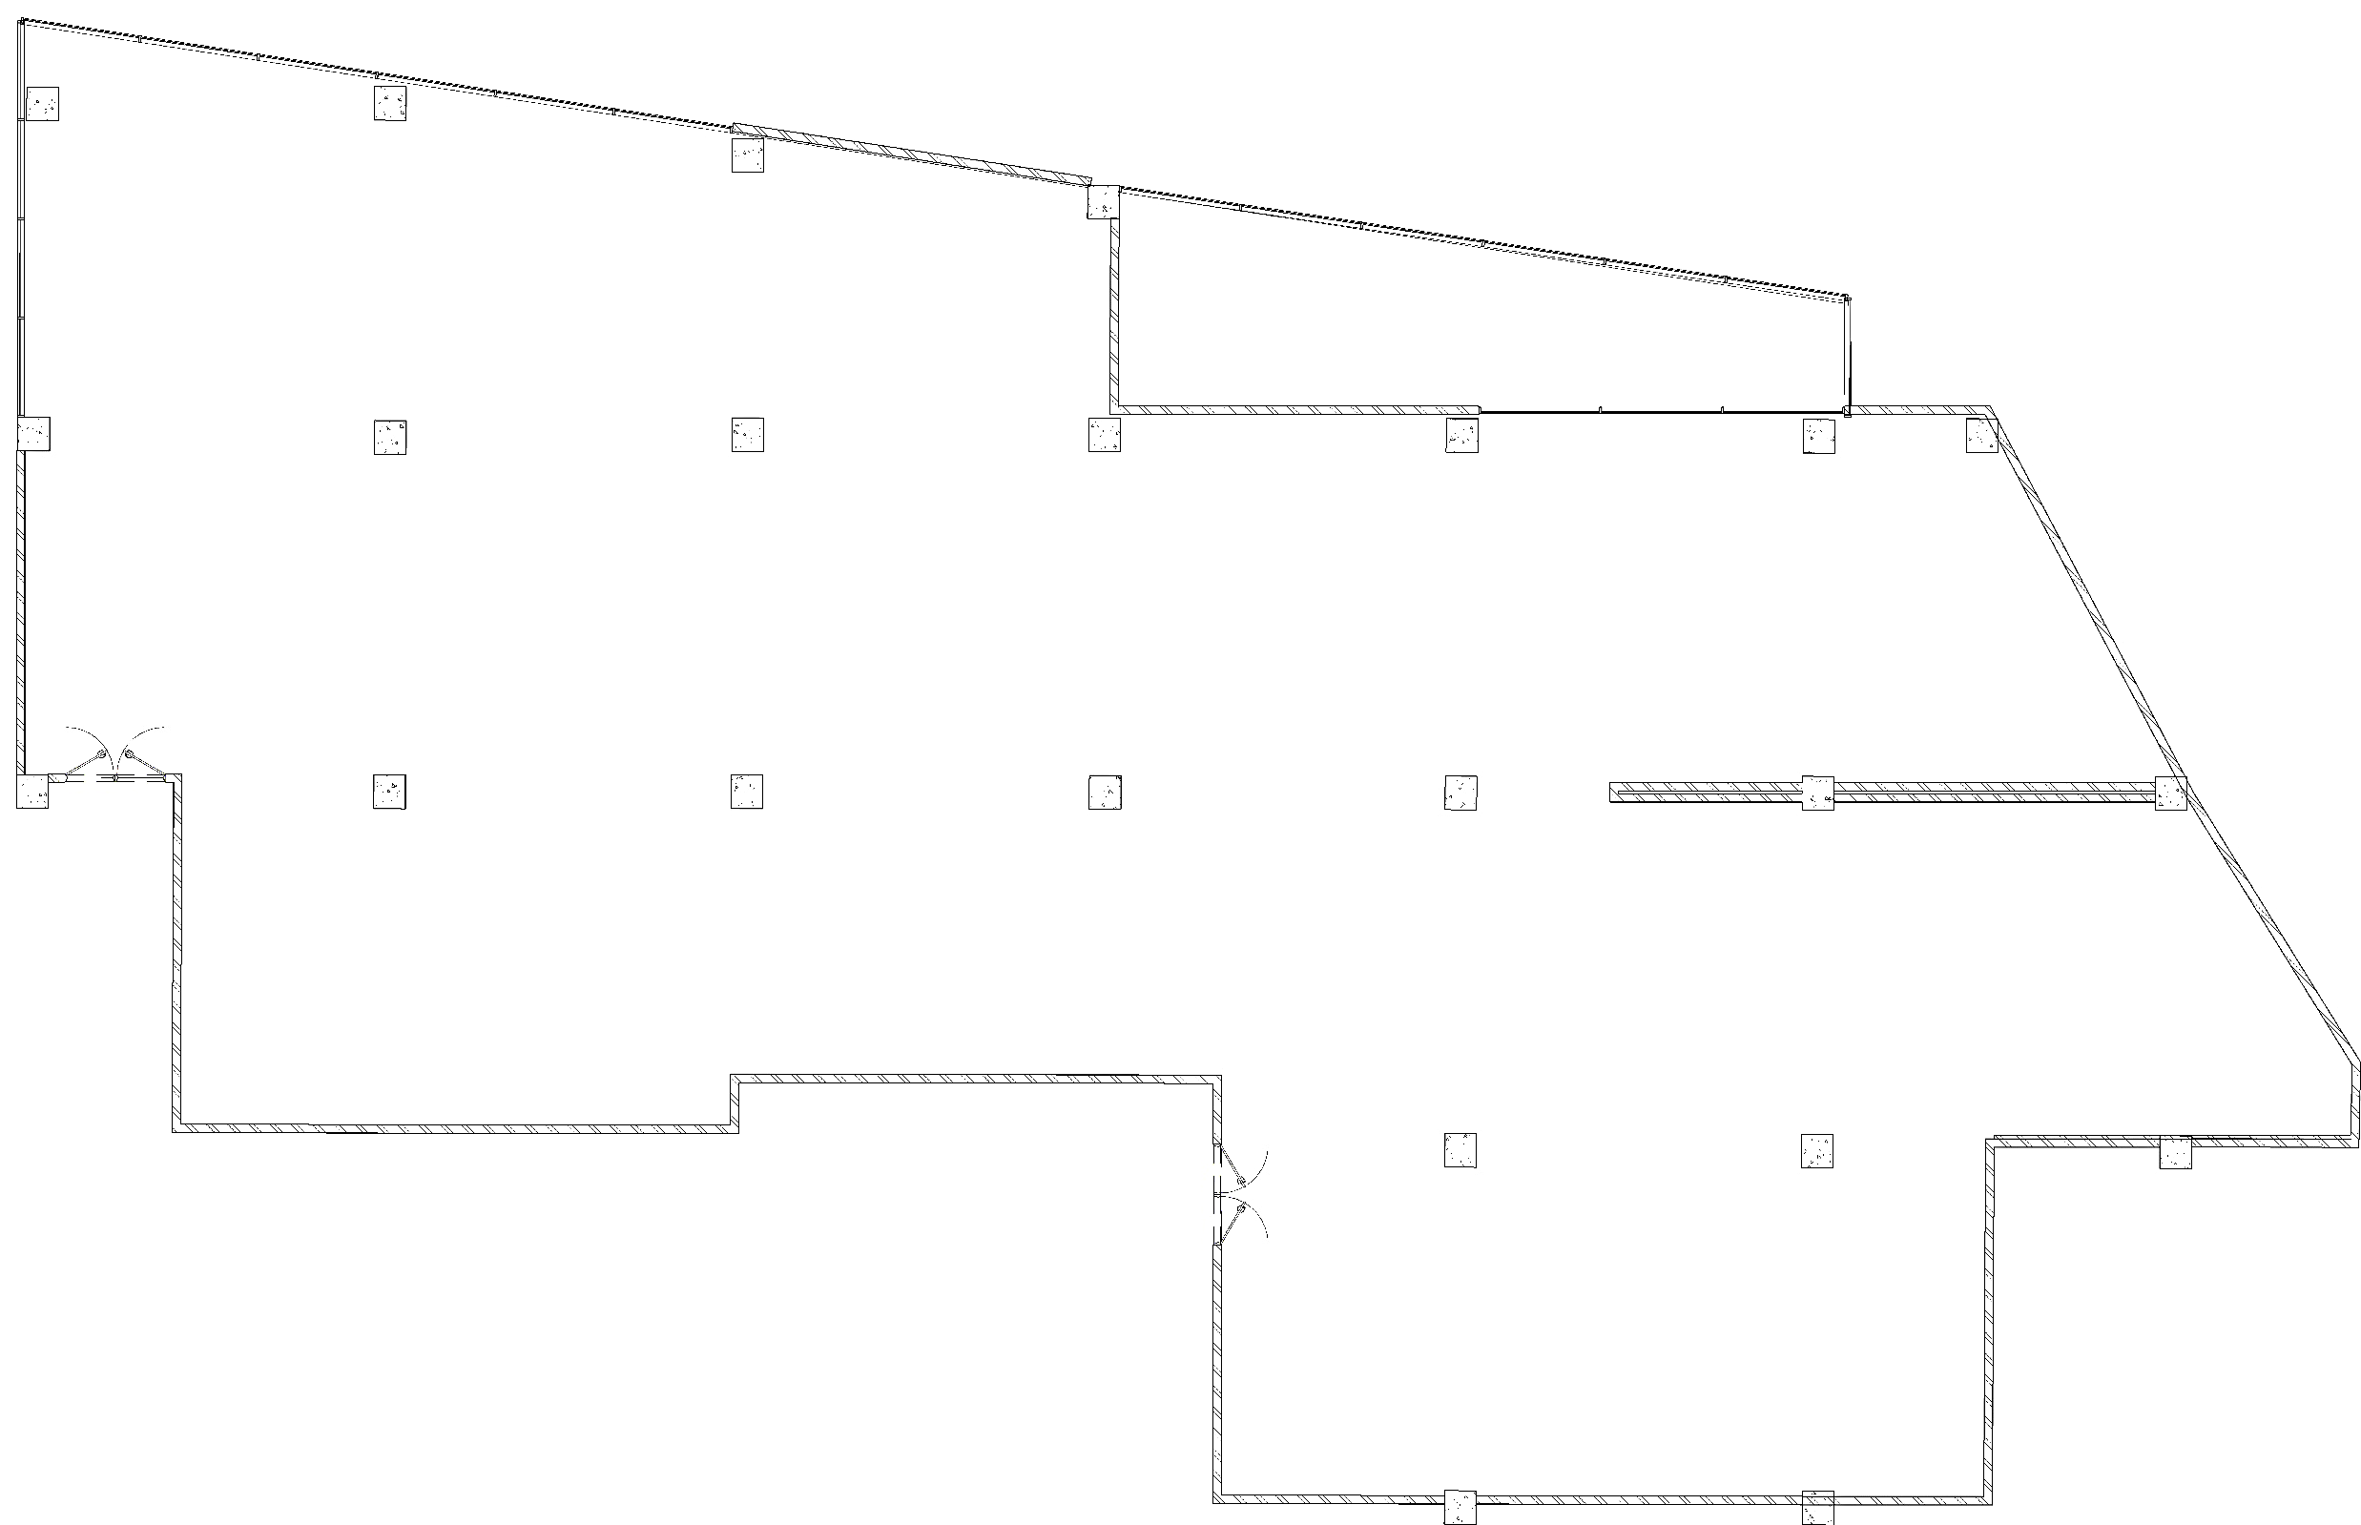
SITE ANALIZE
BALCONY ENTRANCE
SUN LIGHT
BALCONY
SUN LIGHT
SUN LIGHT
STRUCTURAL WALL
STAFF ENTRANCE
MAIN ENTRANCE

Slide 3
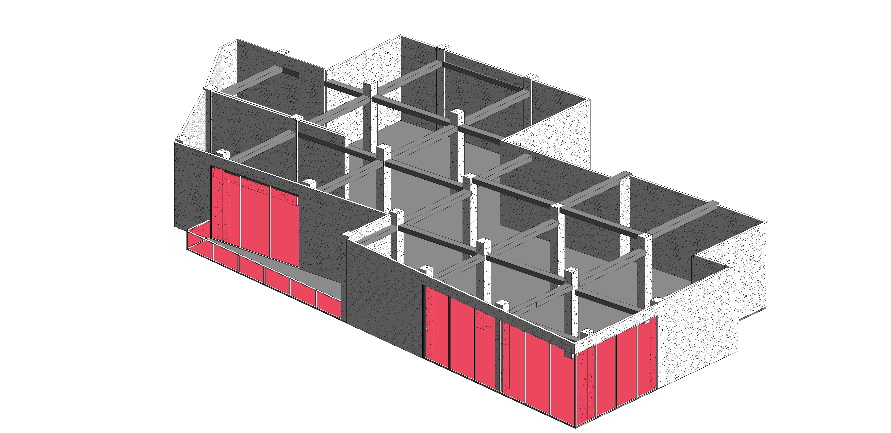
SITE ANALIZE
STRUCTURAL WALL
COLUMN
STAFF ENTRANCE
BALCONY ENTRANCE
SUN LIGHT
BALCONY
MAIN ENTRANCE
SUN LIGHT
STRUCTURAL BEAM

Slide 4
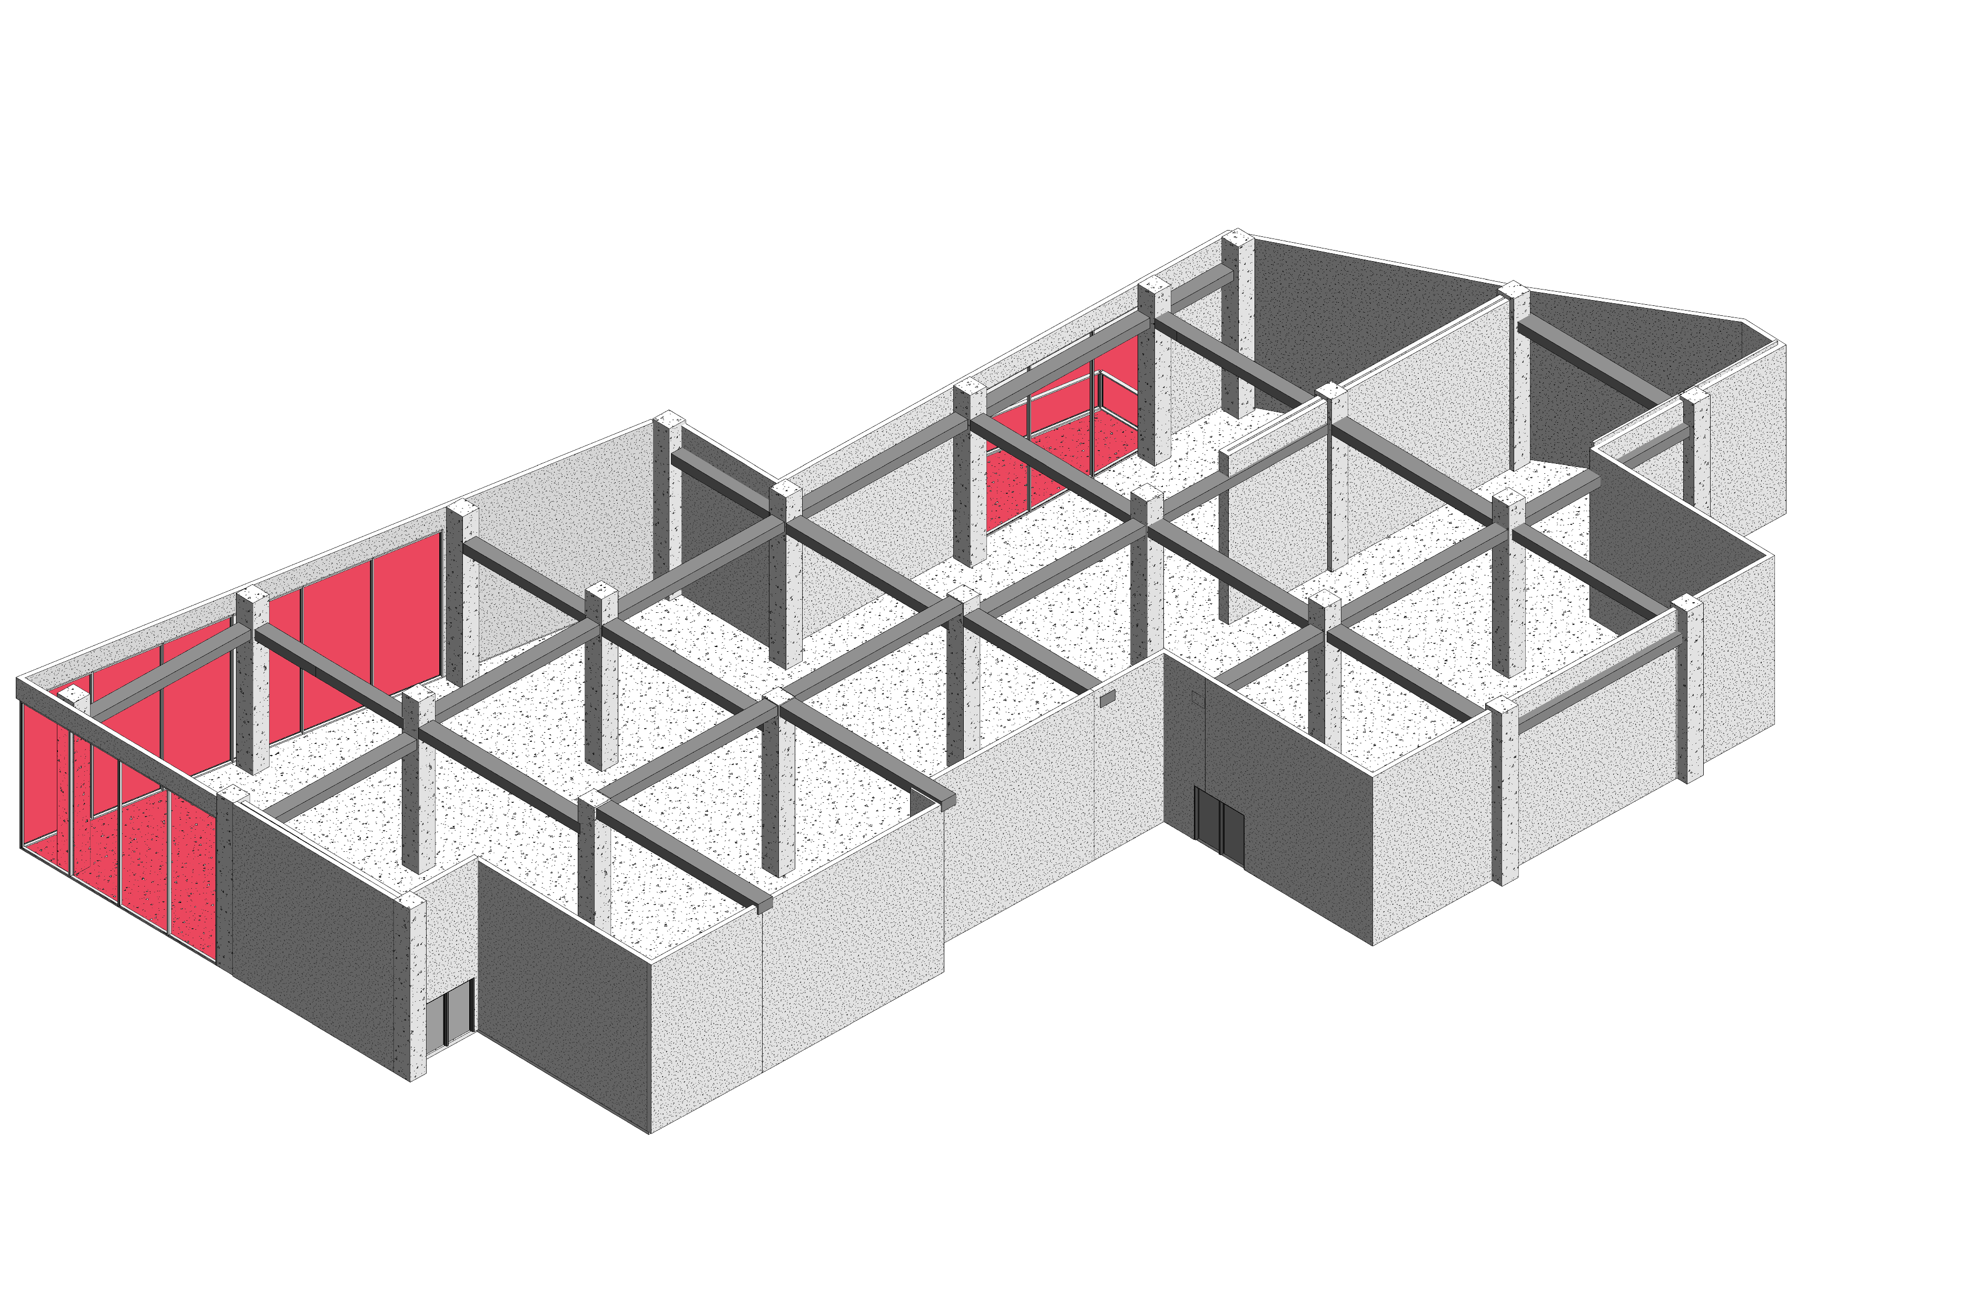
SITE ANALIZE
BALCONY ENTRANCE
SUN LIGHT
STRUCTURAL WALL
BALCONY
COLUMN
SUN LIGHT
SUN LIGHT
STAFF ENTRANCE
MAIN ENTRANCE
STRUCTURAL BEAM

Slide 5
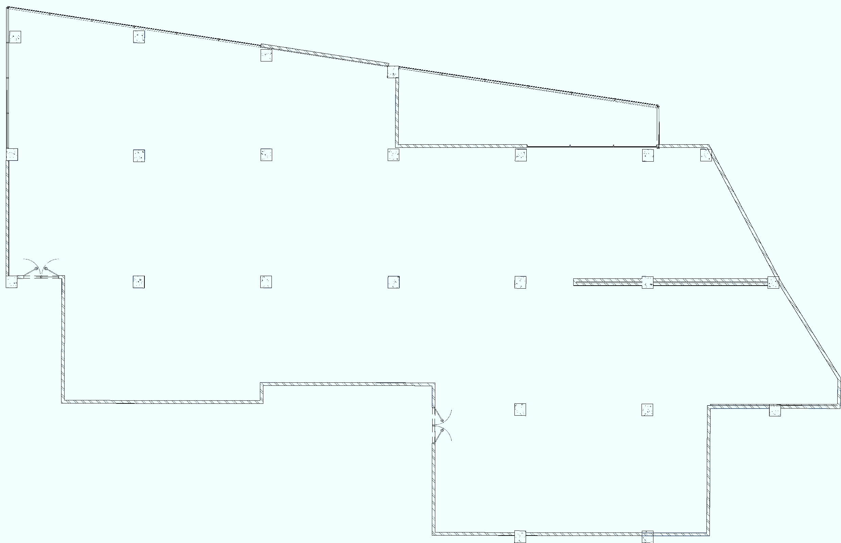
PROGRAM DIAGRAM
VIP LOUNGE
BALCONY
MAIN ENT
RESTAURANT AREA
BAR
RESTROOM
DJ STAGE
STAFF ENT
KITCHEN

Slide 6
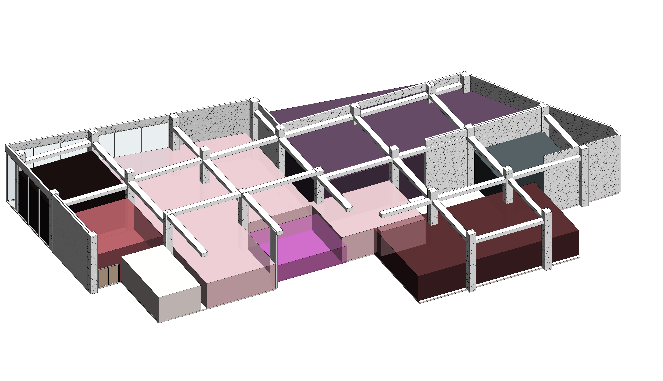
PROGRAM DIAGRAM
RESTAURANT AREA
SMOKING AREA
VIP LOUNGE
RESTROOM
MAIN ENTRANCE
BAR
DJ STAGE
KITCHEN

Slide 7
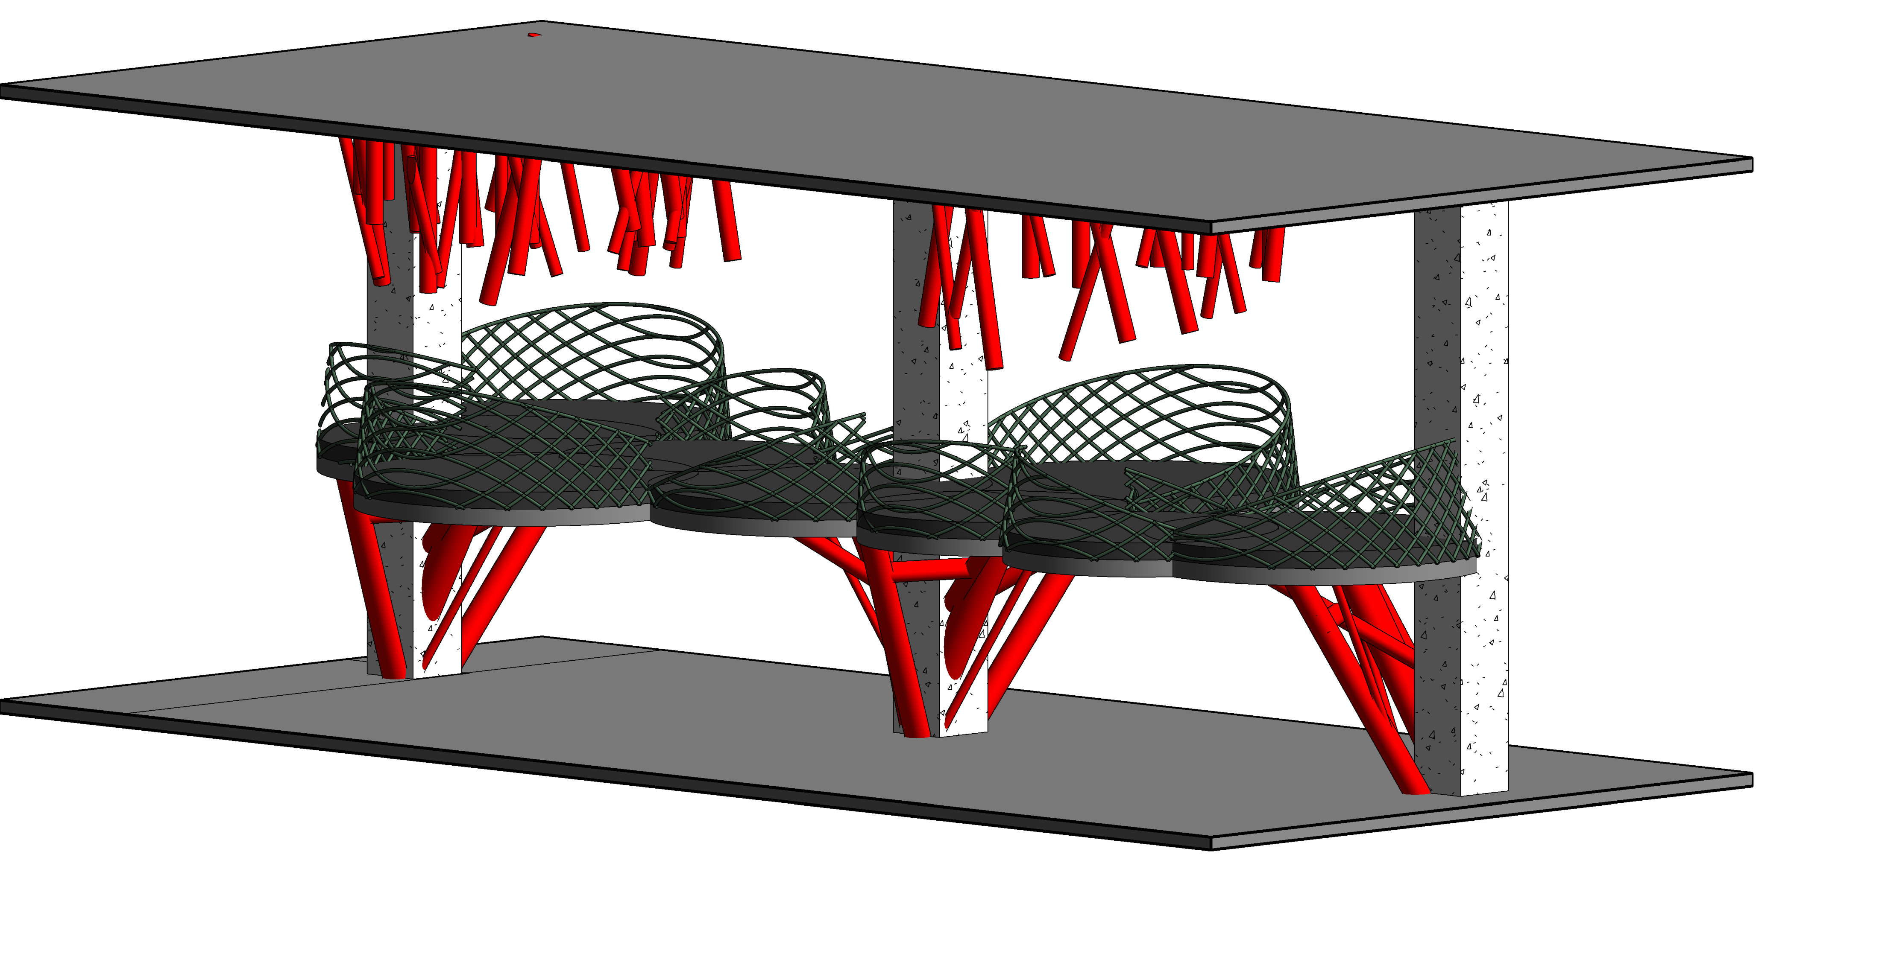
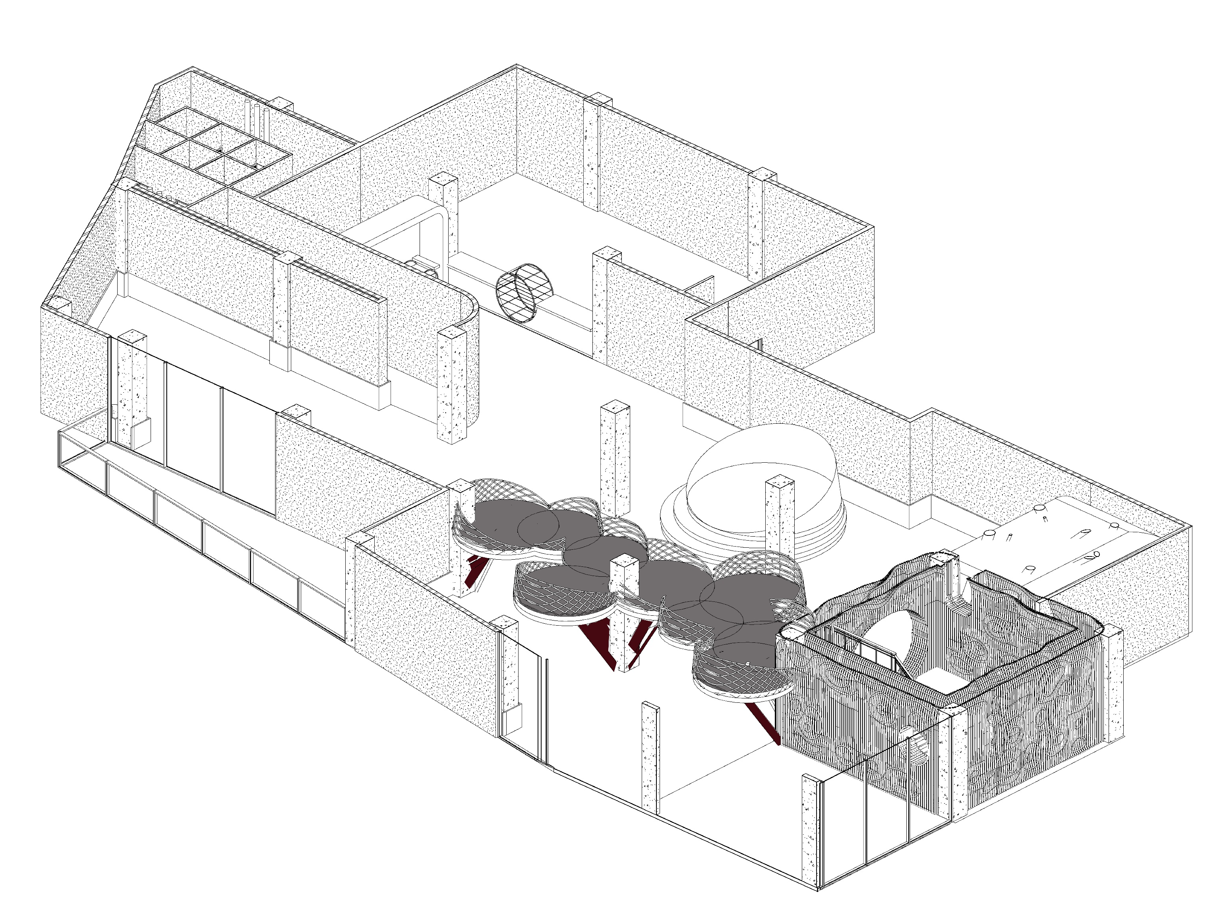
MAIN IDEA
MEZZANINE

Slide 8
PROGRAM TABLE
NO. | SPACE/ACTIVITY | EXISTING SPACE (Square meters) | NOTES
1 | ENTRANCE | 80 | UNIQUE DESIGN
2 | STAGE | 40
3 | MAIN RESTAURANT AREA | 464
4 | VIP LOUNGE | 80
5 | SMOKING AREA | 200
6 | BAR | 50
7 | RESTROOM | 80 | MEN AND WOMEN
8 | KITCHEN | 150 | INCLUDING STORAGE , LOCKER , BAKING ,GARNISHING ,WASHING
9 | BAKERY | 20
10 | BALCONY | 67
11 | MEZZANINE | 100 | VIEW TO THE STAGE
12 | TOTAL | 1331 | INCLUDING MEZZANINE

Slide 9
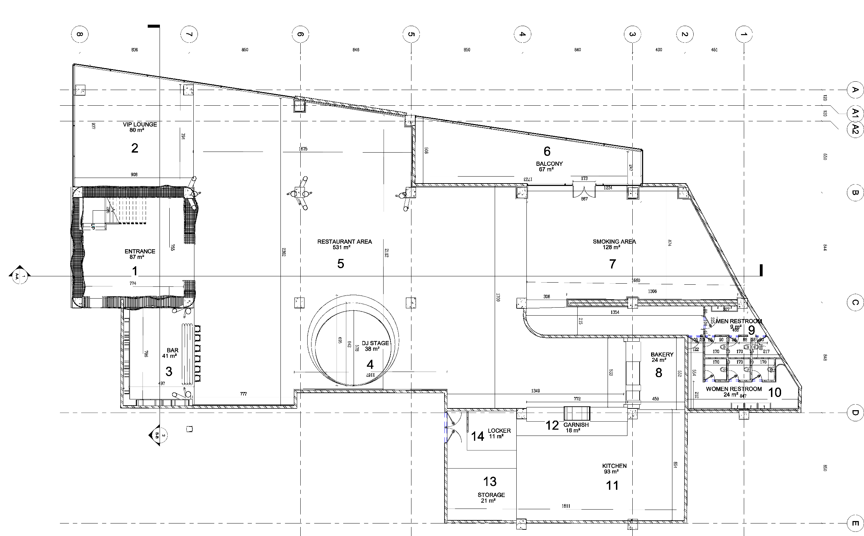
DIMENTION PLAN
1.ENTRANCE
2.VIP LOUNGE
3.BAR
4.DJ STAGE
5.RESTAURANT MAIN AREA
6.BALCONY
7.SMOKING AREA
8.BAKERY
9.MEN RESTROOM
10.WOMEN RESTROOM
11.KITCHEN
12.GARNISH
13.STORAGE
14.LOCKER
N

Slide 10
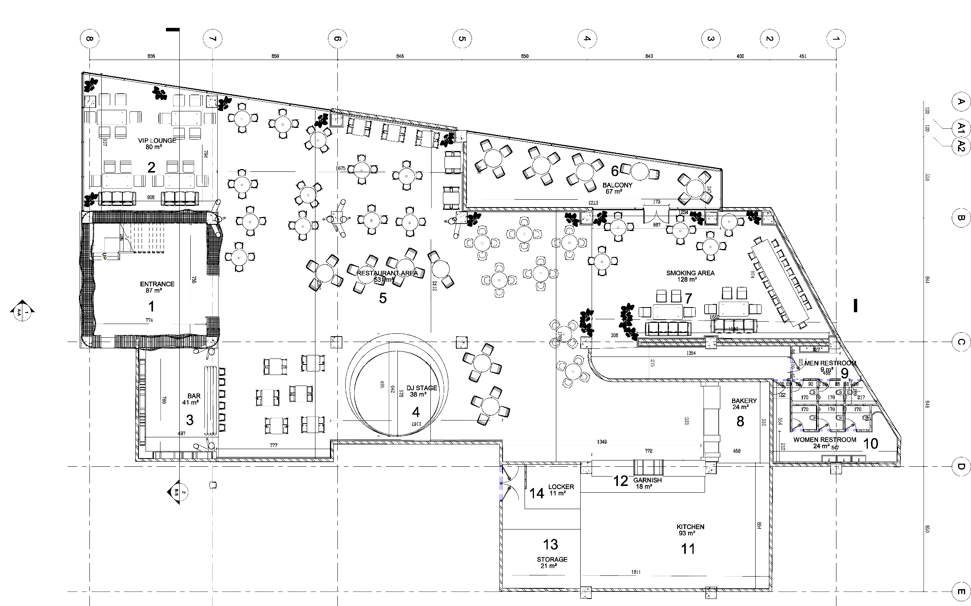
FURNITURE PLAN
1.ENTRANCE
2.VIP LOUNGE
3.BAR
4.DJ STAGE
5.RESTAURANT MAIN AREA
6.BALCONY
7.SMOKING AREA
8.BAKERY
9.MEN RESTROOM
10.WOMEN RESTROOM
11.KITCHEN
12.GARNISH
13.STORAGE
14.LOCKER
N

Slide 11
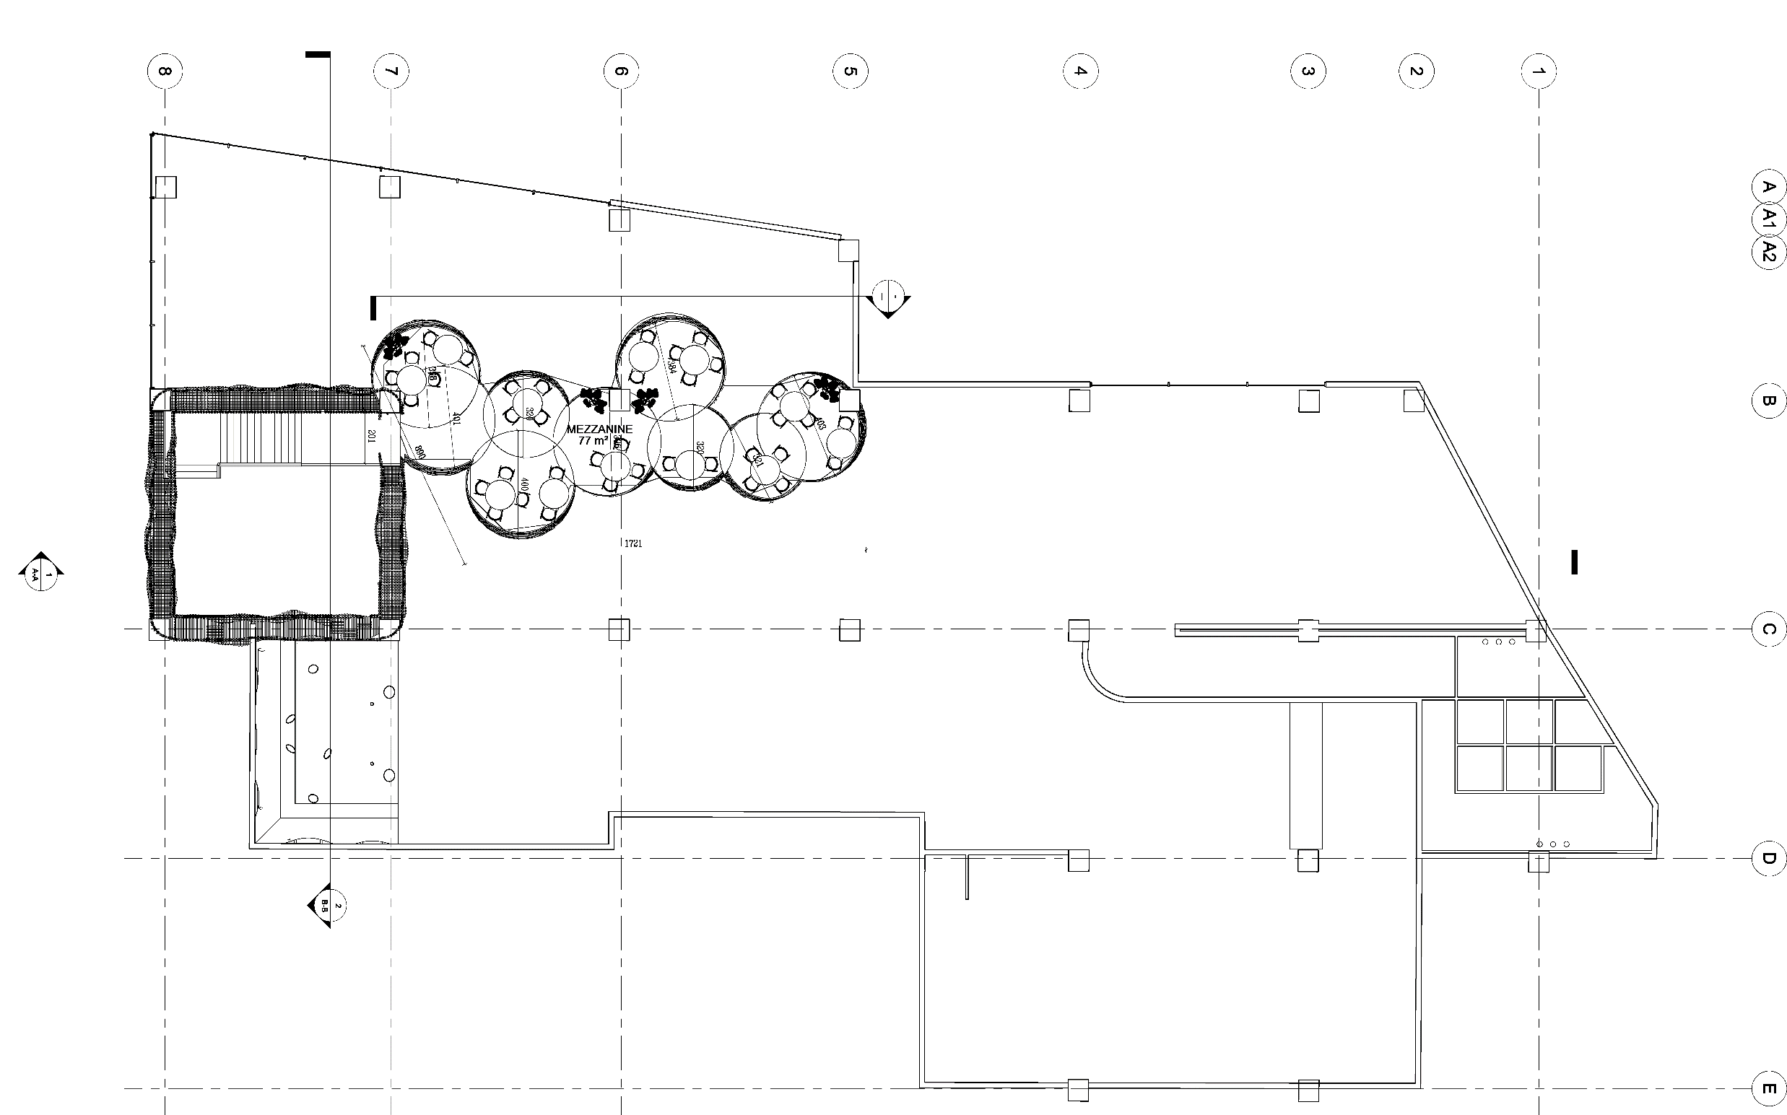
MEZZANINE PLAN
N

Slide 12
SECTION A-A
ENTRANCE
MEZZANINE
MAIN RESTAURANT AREA
SMOKING AREA
SOCIAL TABLE

Slide 13
SECTION B-B
BAR
ENTRANCE
VIP LOUNGE

Slide 14
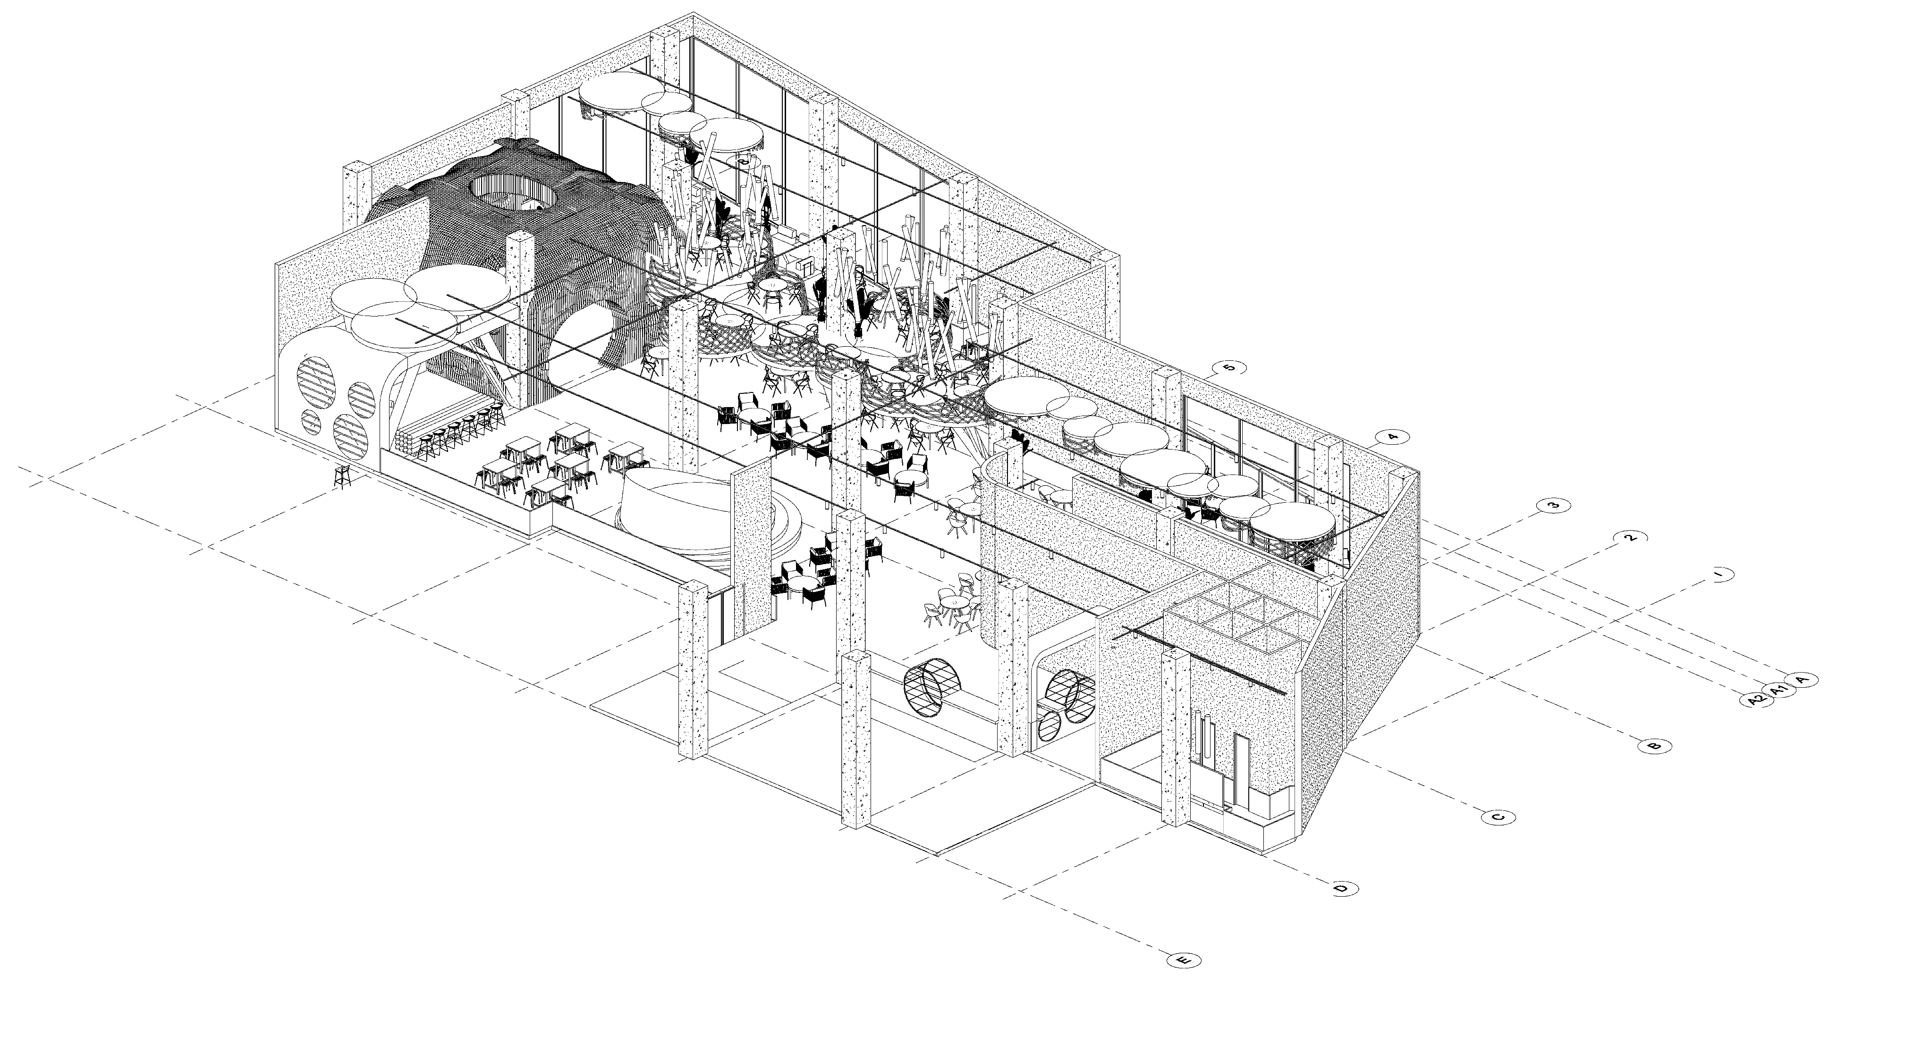
3D SECTION
ENTRANCE
MEZZANINE
SMOKING AREA
VIP LOUNGE
RESTROOM
SOCIAL TABLE
BAR
DJ STAGE
KITCHEN
MAIN RESTAURANT AREA
BAKERY

Slide 15
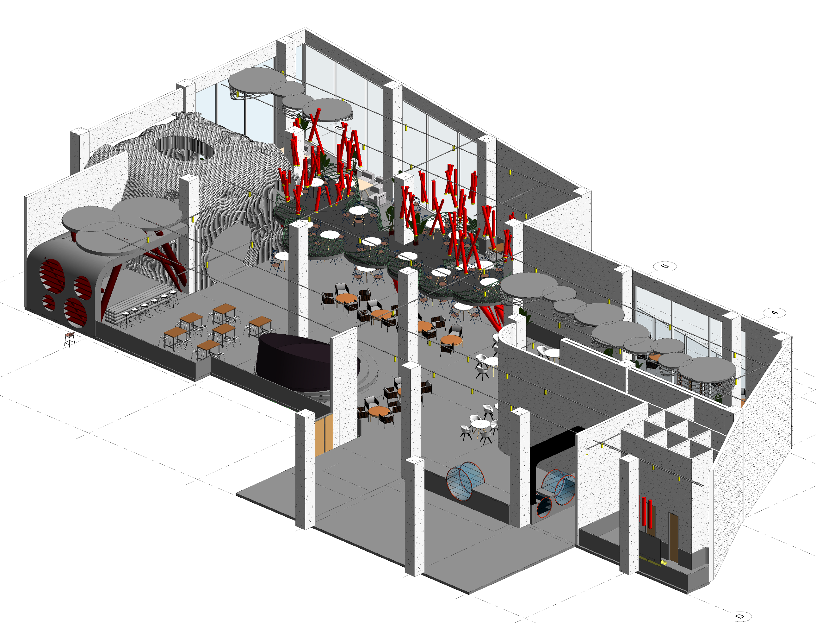
3D SECTION
MEZZANINE
ENTRANCE
SMOKING AREA
VIP LOUNGE
RESTROOM
SOCIAL TABLE
BAR
DJ STAGE
KITCHEN
MAIN RESTAURANT AREA
BAKERY

Slide 16
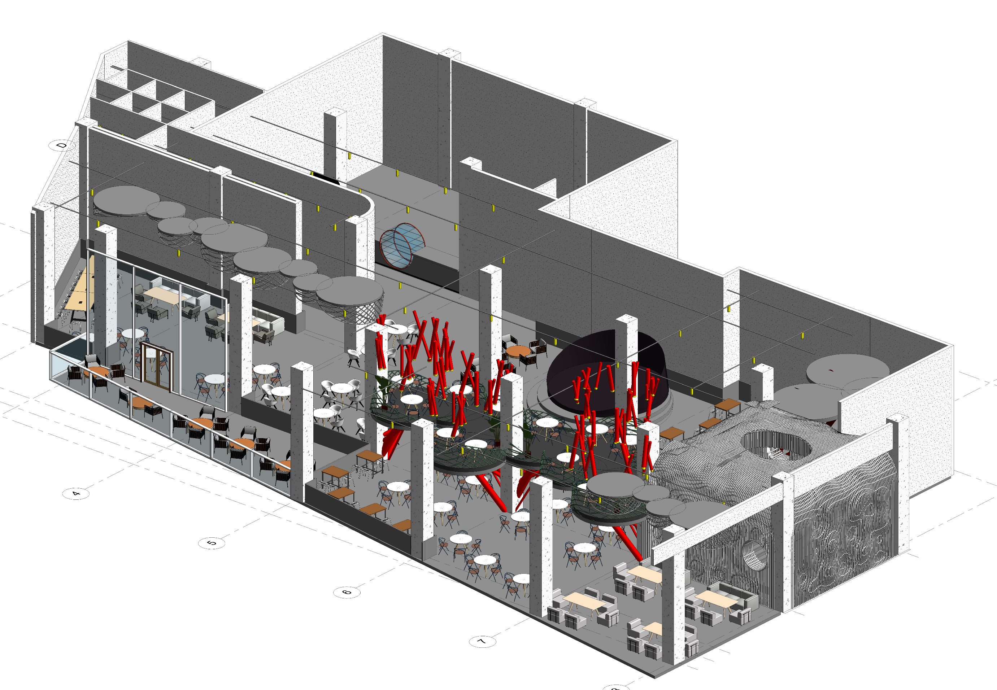
3D SECTION
RESTROOM
KITCHEN
DJ STAGE
ENTRANCE
BAR
SOCIAL TABLE
MEZZANINE
SMOKING AREA
VIP LOUNGE
MAIN RESTAURANT AREA
BAKERY

Slide 24
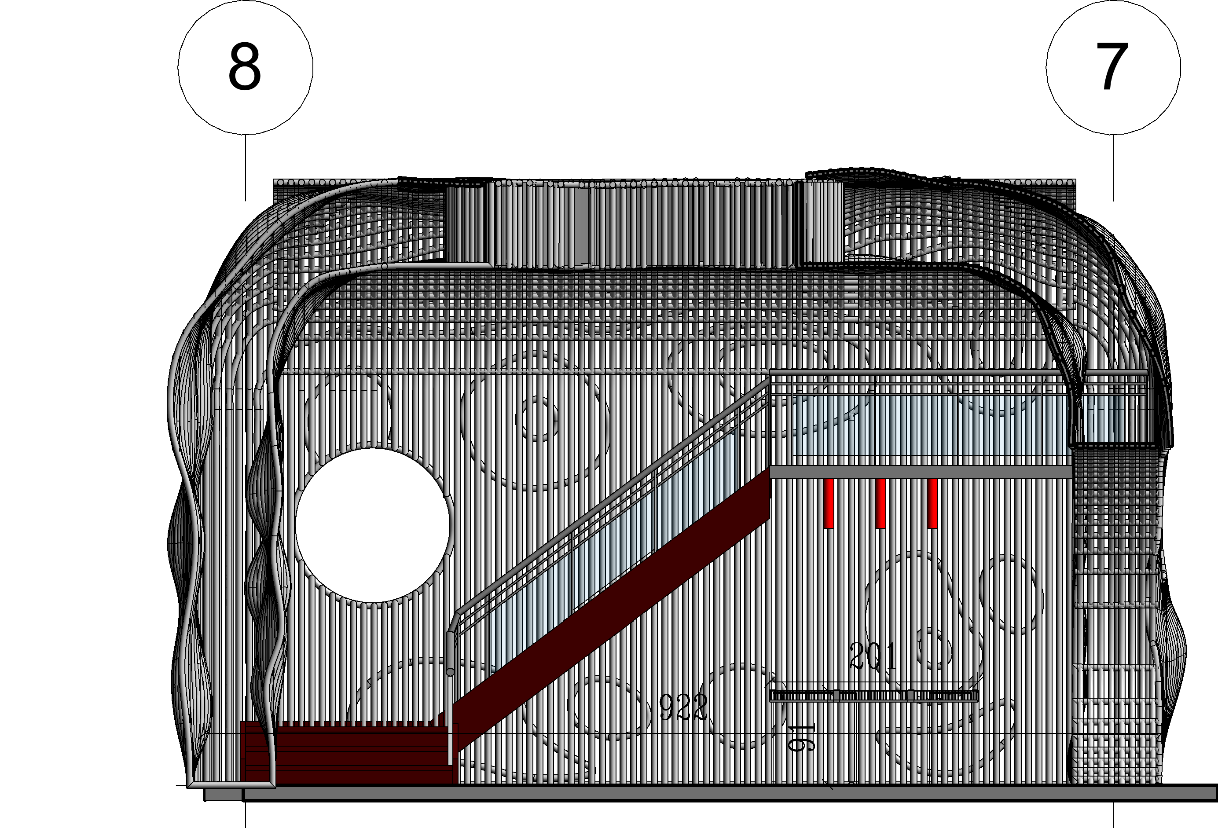
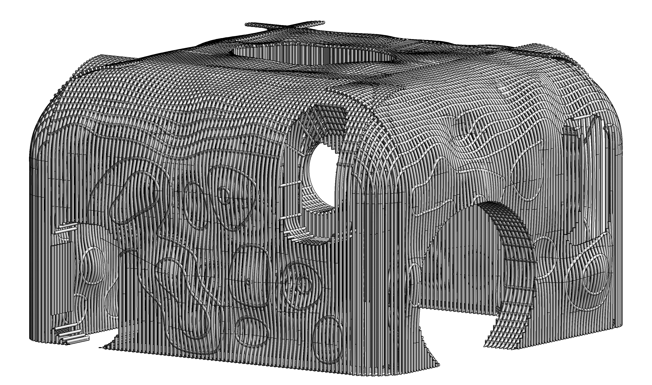
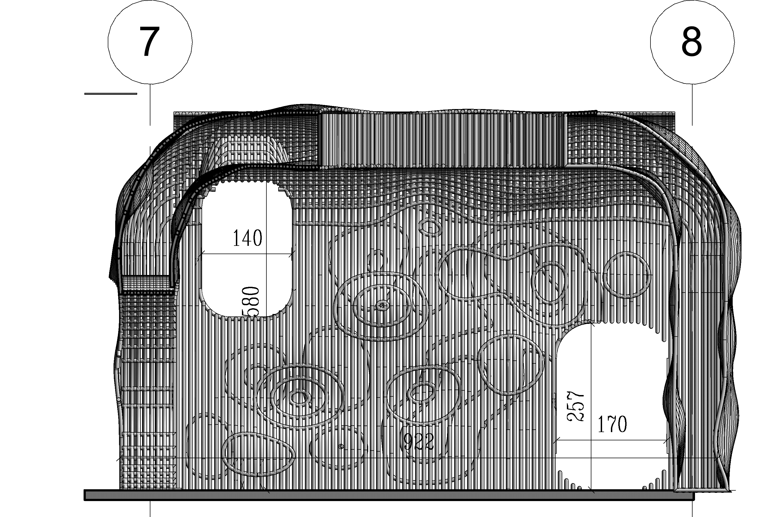
ENTRANCE
THIN WALL PIPE
250
250
BAR
MEZZANINE
MAIN ENTRANCE
RESTAURANT HALL

Slide 25
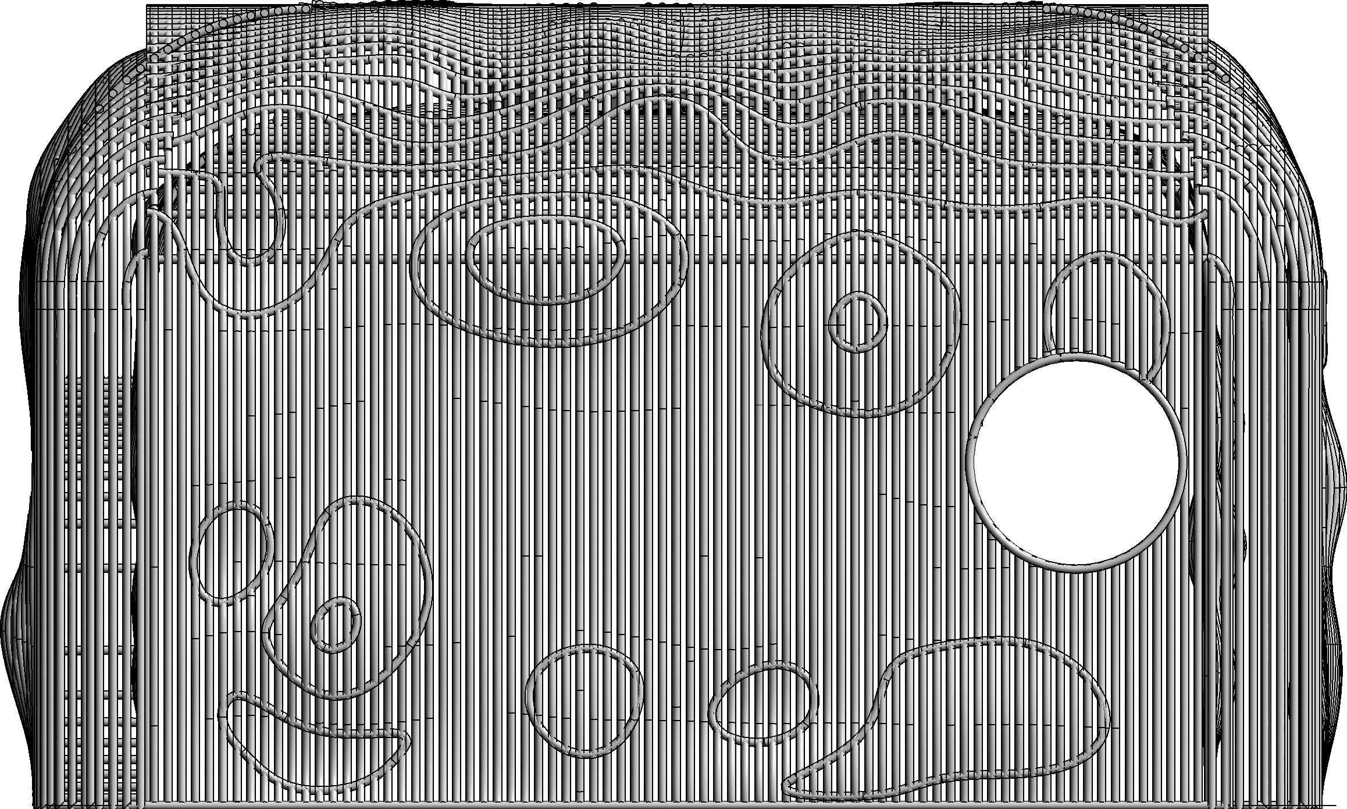
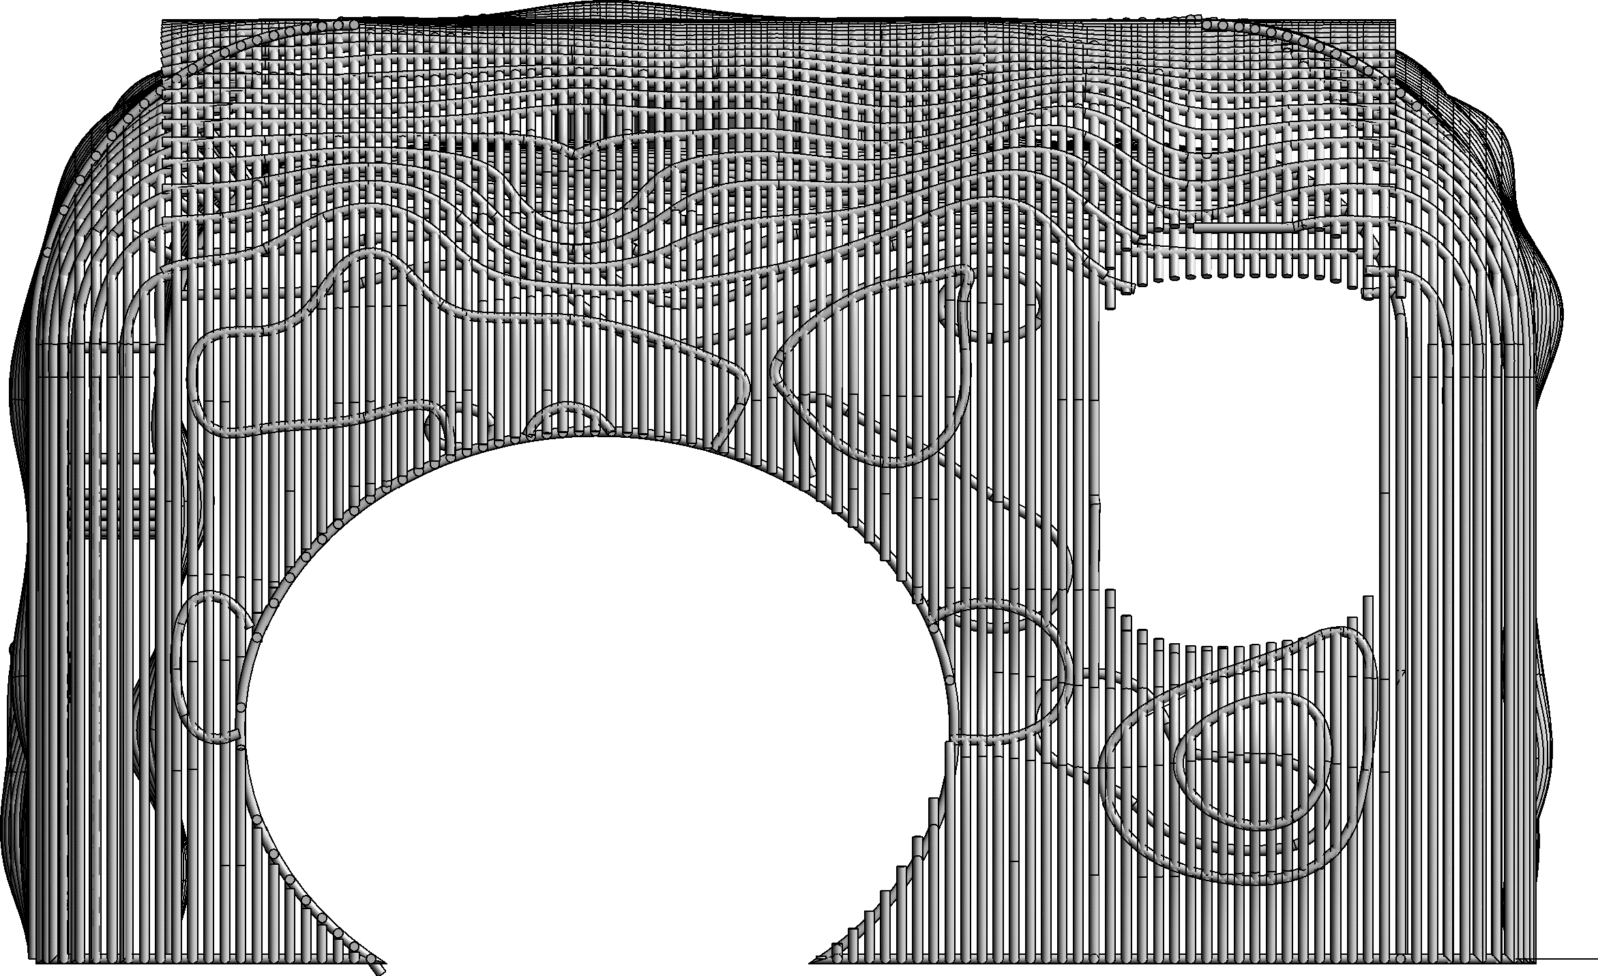
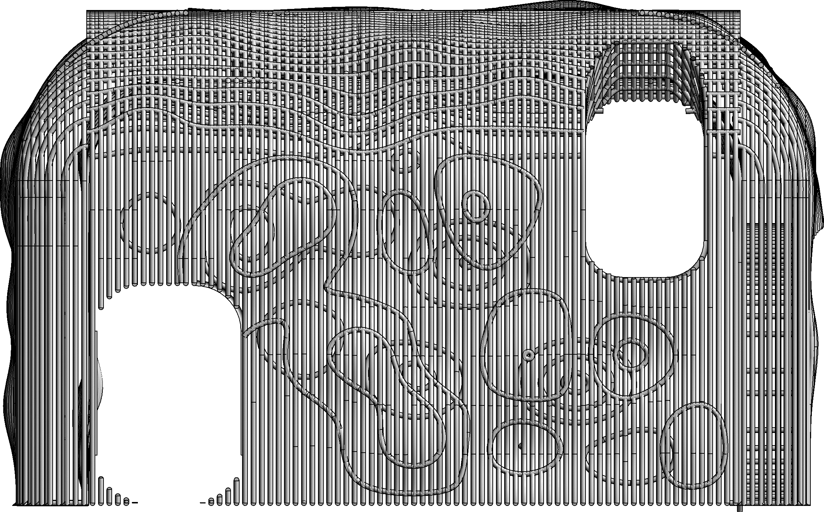
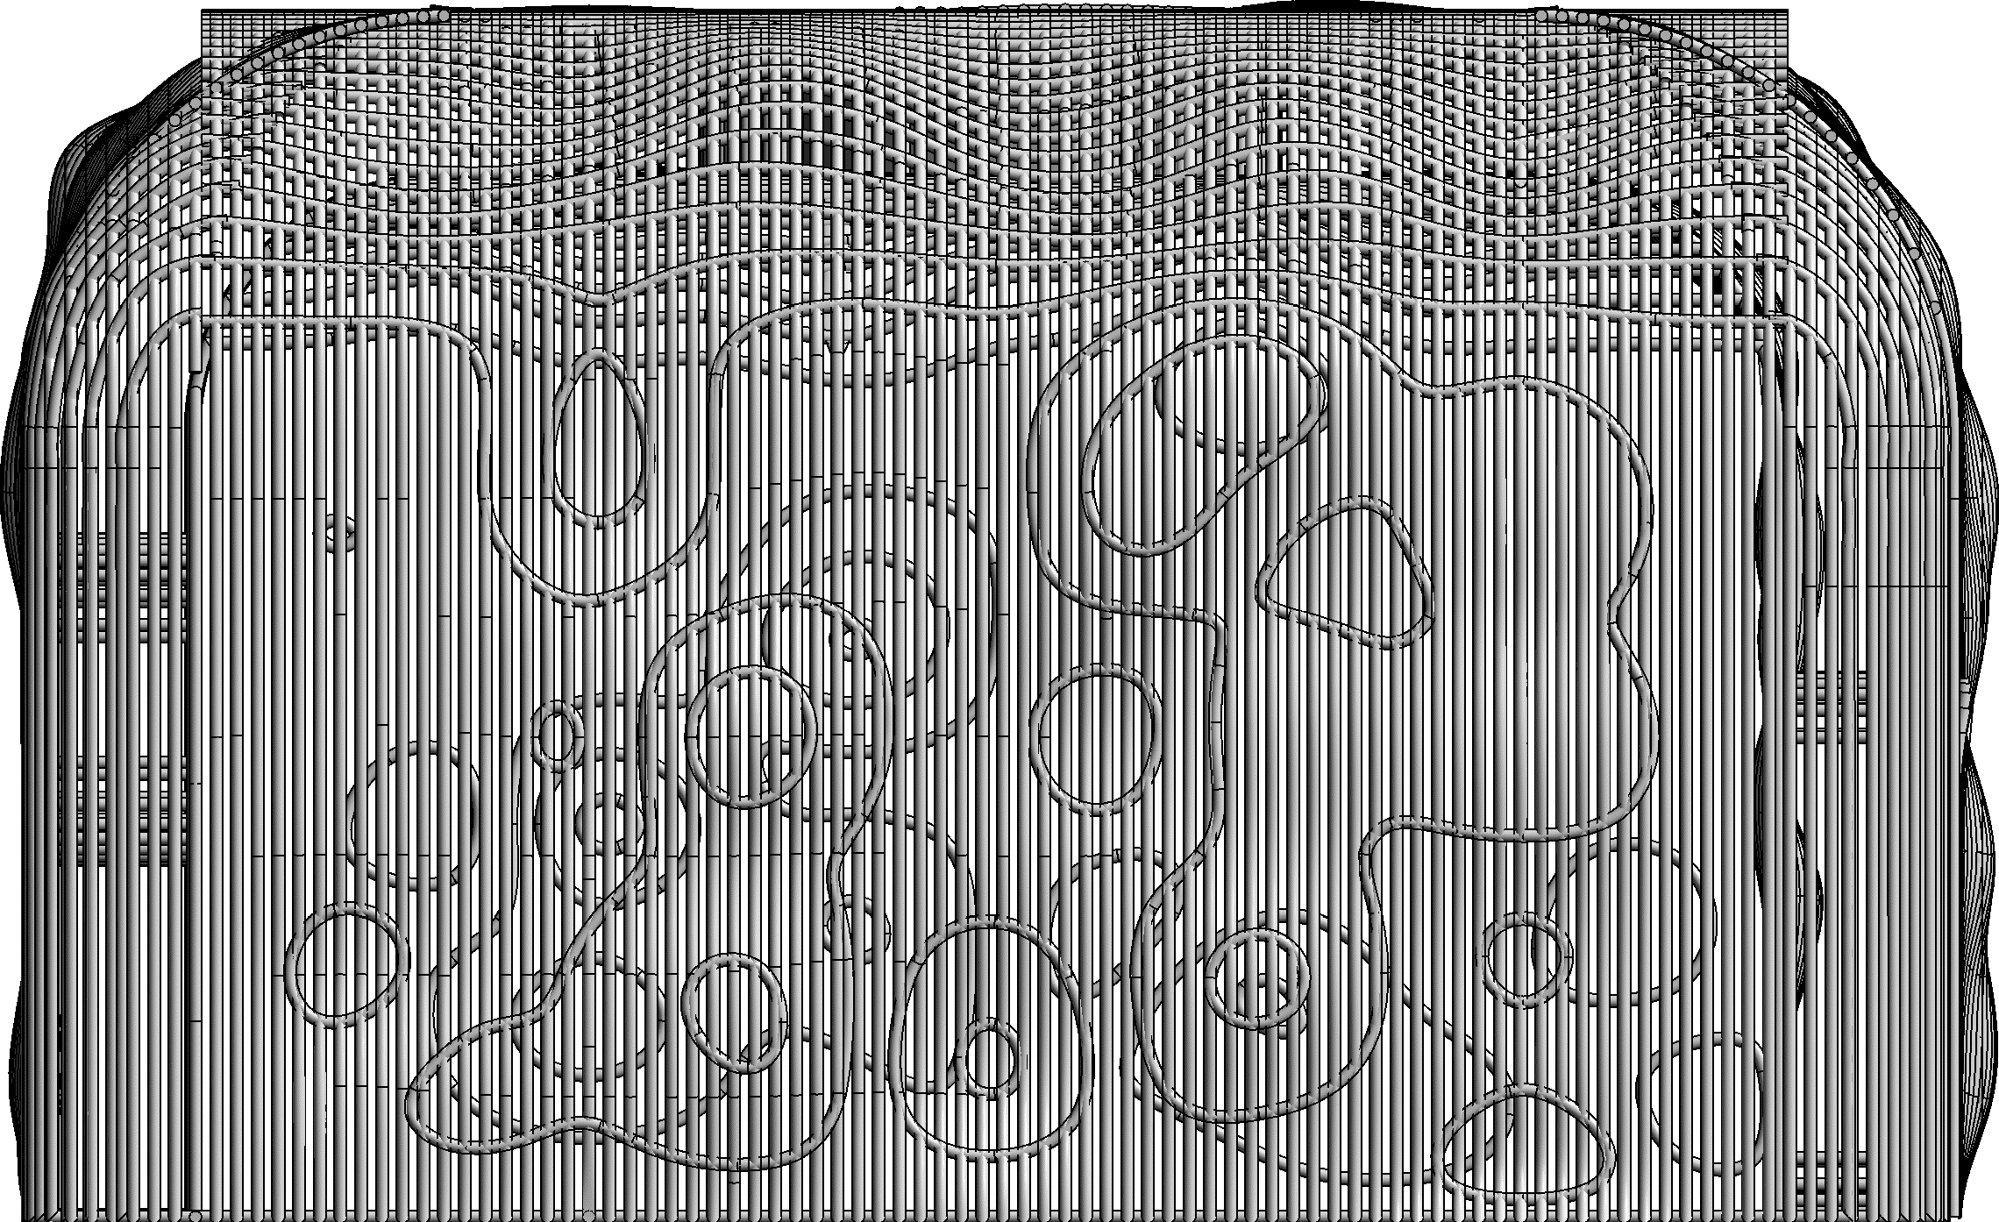
ENTRANCE
WEST ELEVATION (VIP LOUNGE)
NORTH ELEVATION (RESTAURANT ENTERANCE)
EAST ELEVATION (MALL ENTERANCE)
SOUTH ELEVATION (MALL VIEW)

Slide 27
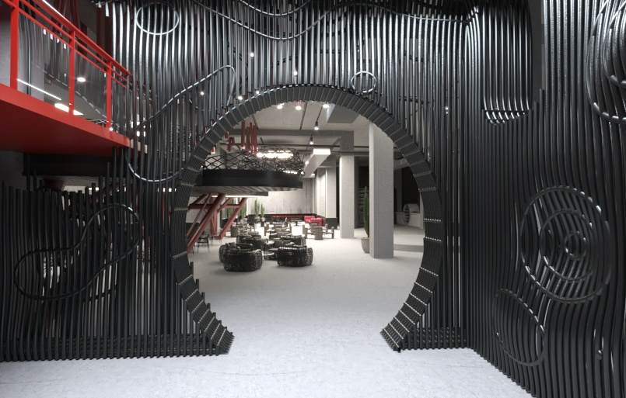

Slide 28
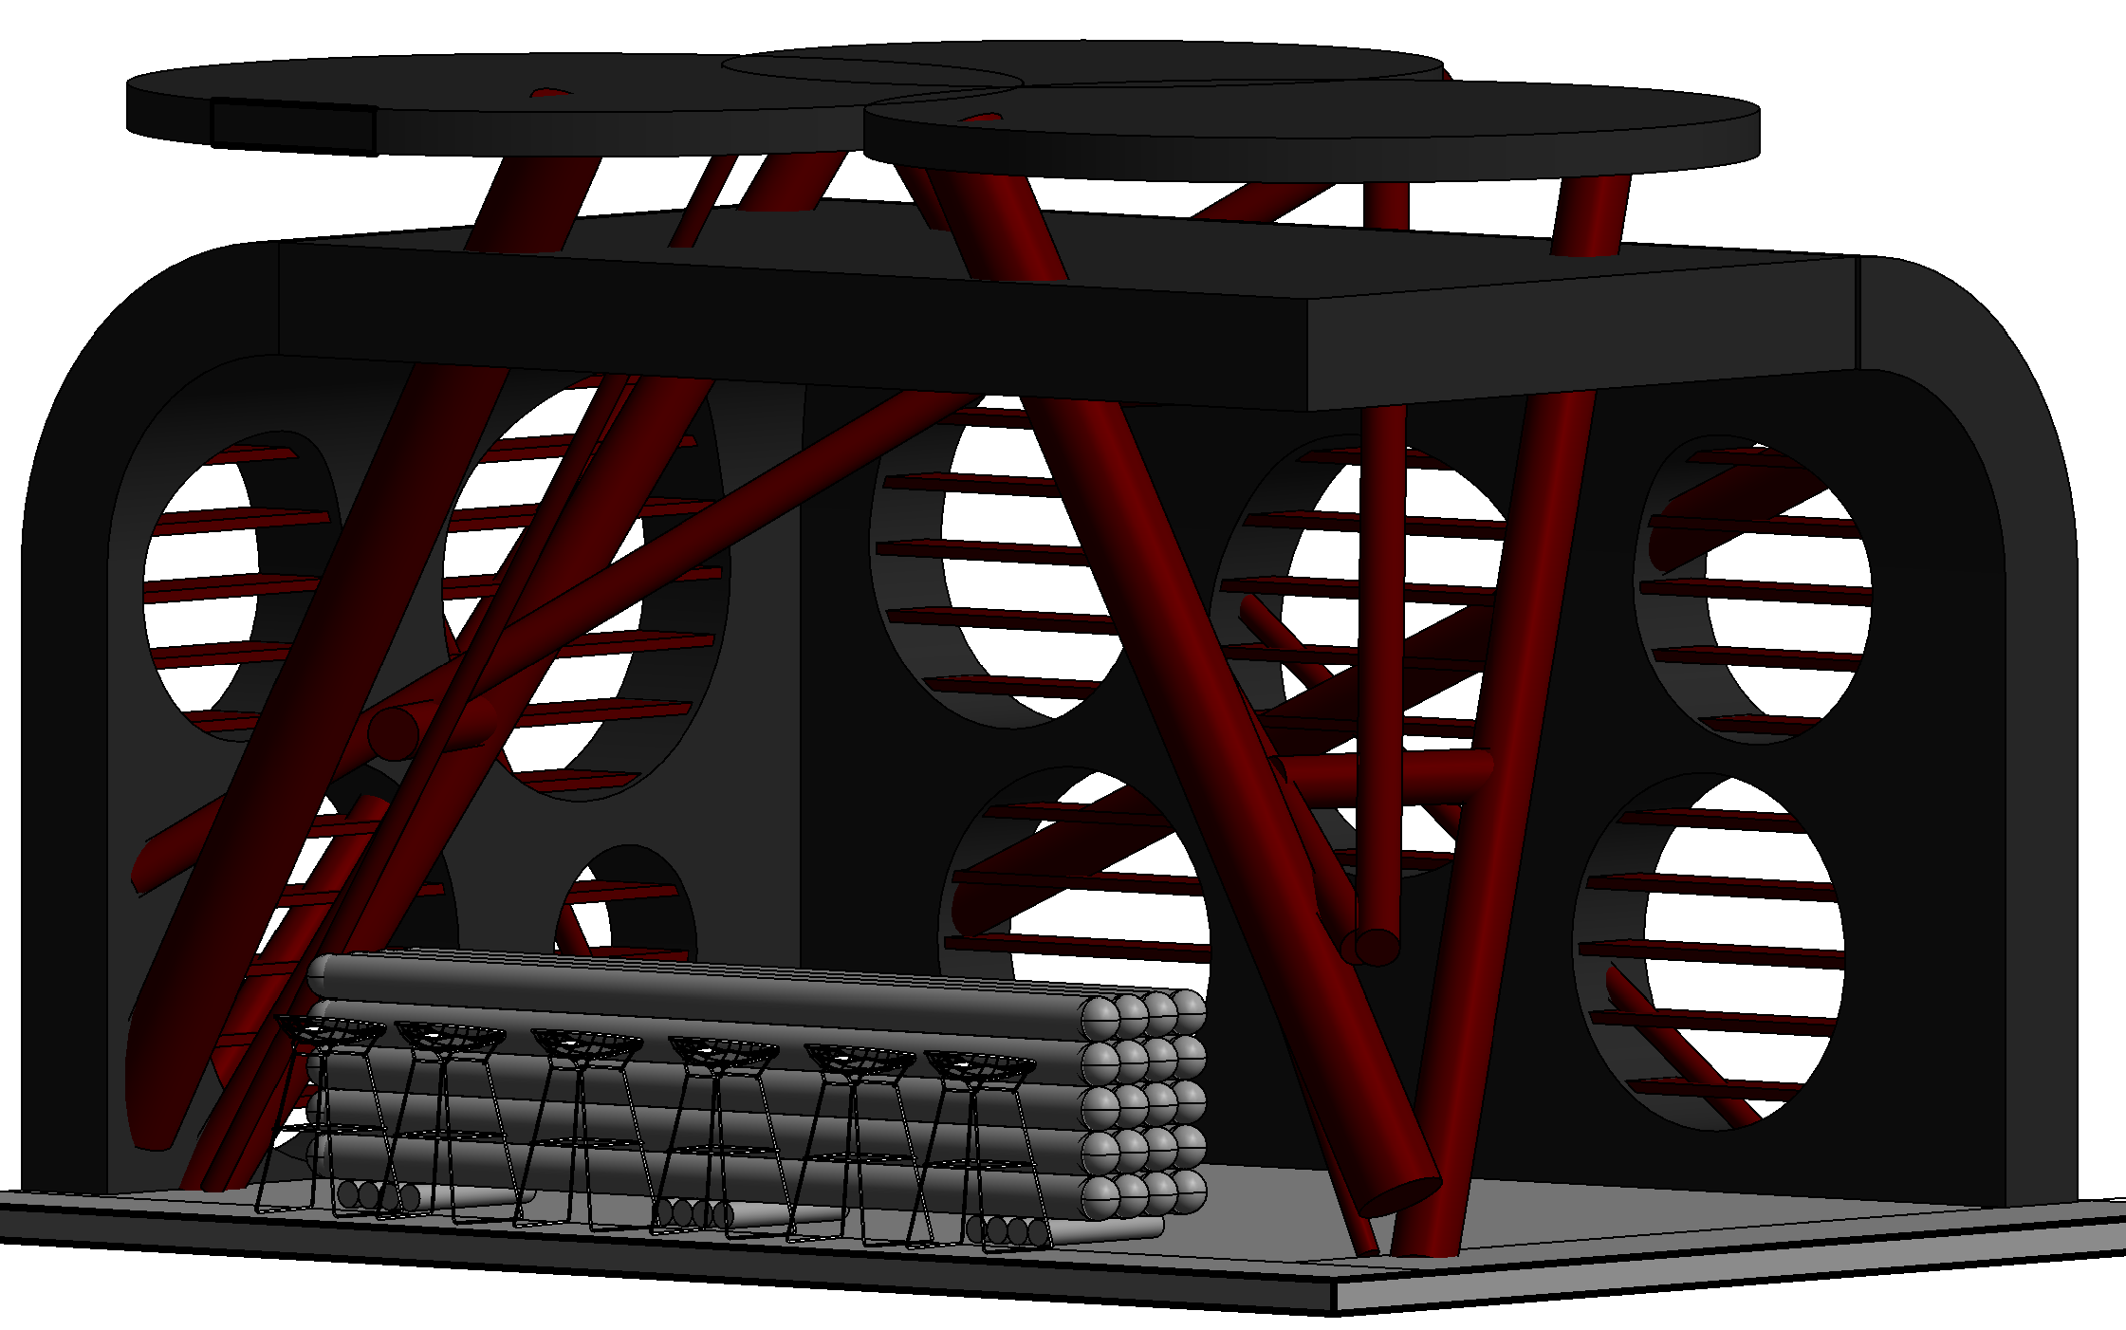
BAR
MANISMAN PIPE
THIN WALL PIPE
CHROME MEMBRANE LAYER PIPE
FINISHING LAYER MICROCEMENT
IRON SHEET

Slide 30
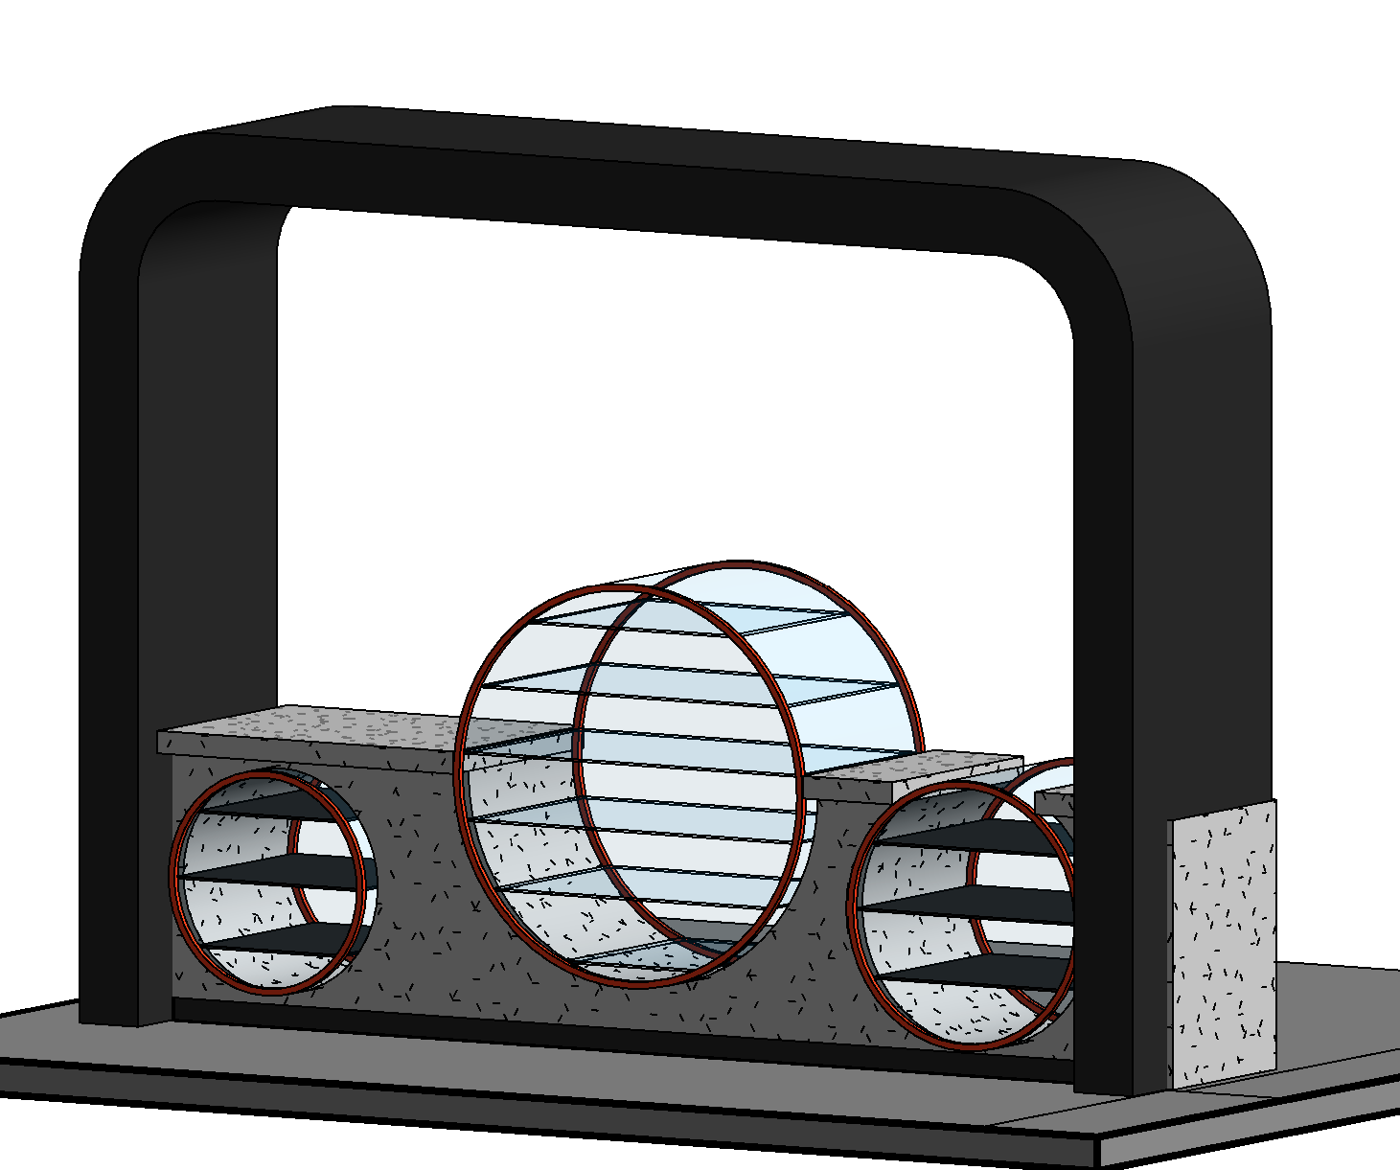
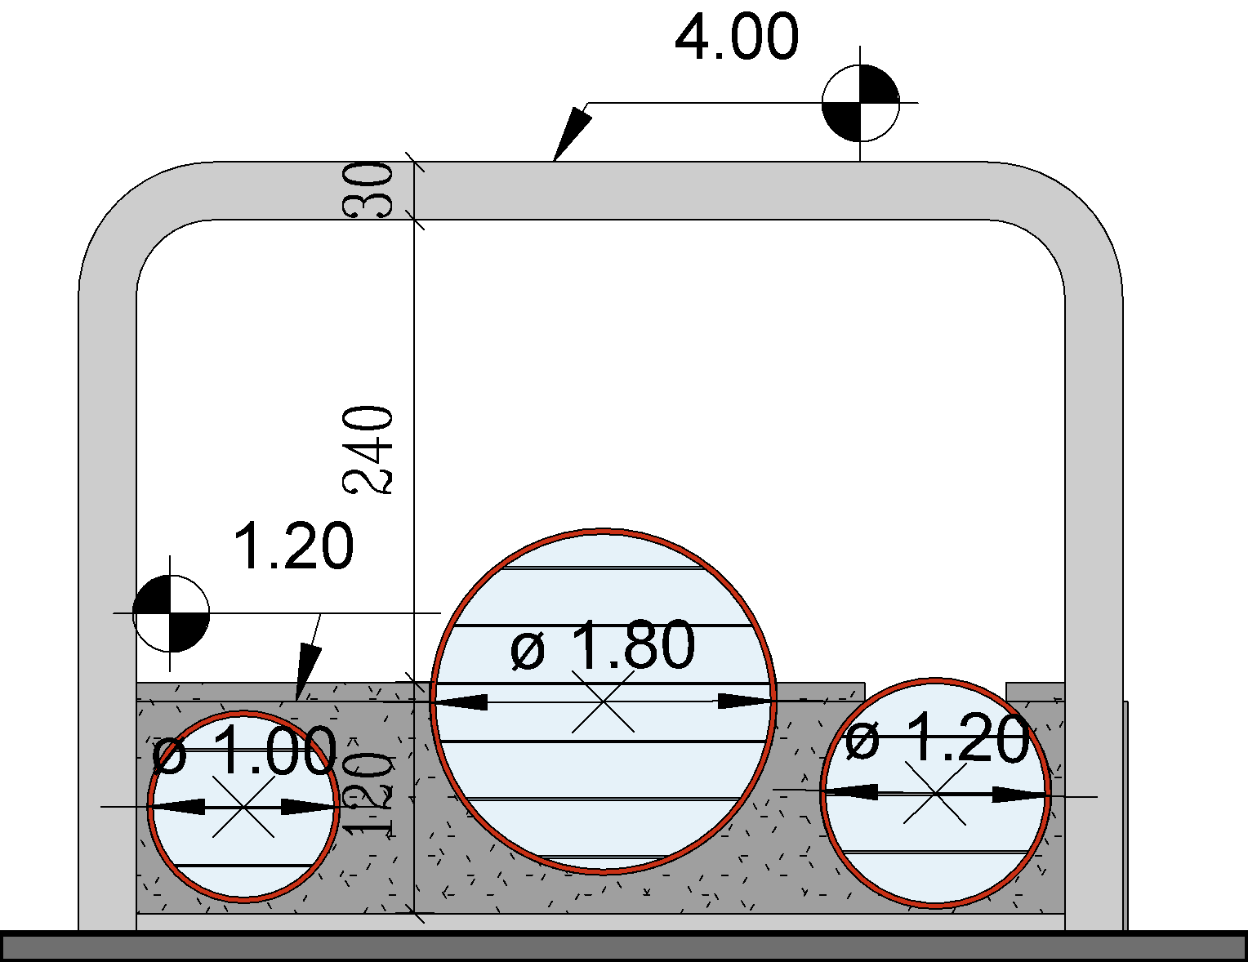
BAKERY
GLASS SHOW CASE
IRON SHEET
CONCRETE TILE
IRON PROFILE
FINISHING LAYER MICROCEMENT

Slide 31
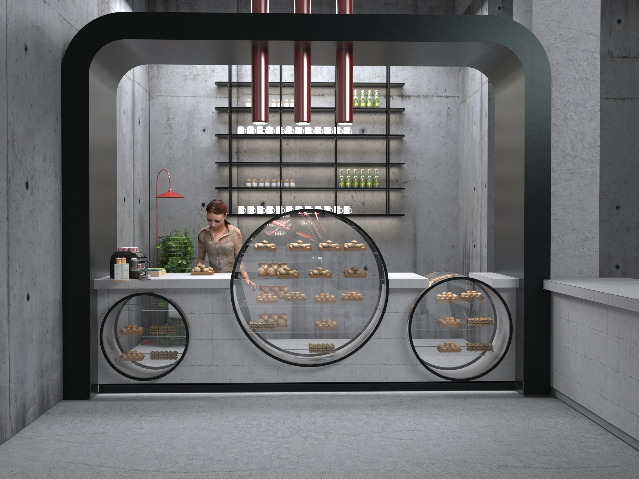
MAIN IDEA

Slide 32
WC LAYOUT
CONCRETE LAYER
STRUCTURE WALL
STRUCTURE WALL
PUNCH METAL
HANGER
SUBSTRATE LAYER CEMENT
WALL HANG PUSH BUTTON
FINISHING LAYER MICROCEMENT
FINISHING LAYER
60*120 RAK CERAMIC TILE
KWC TOILET FAUCET
100 CM
WALL HANG
MAX 55 CM
FINISHING LAYER MICROCEMENT
FINISHING LAYER MICROCEMENT
SUBSTRATE LAYER CEMENT
INSULATION LAYER
CONCRETE LAYER
STRUCTURAL CEILING

Slide 33
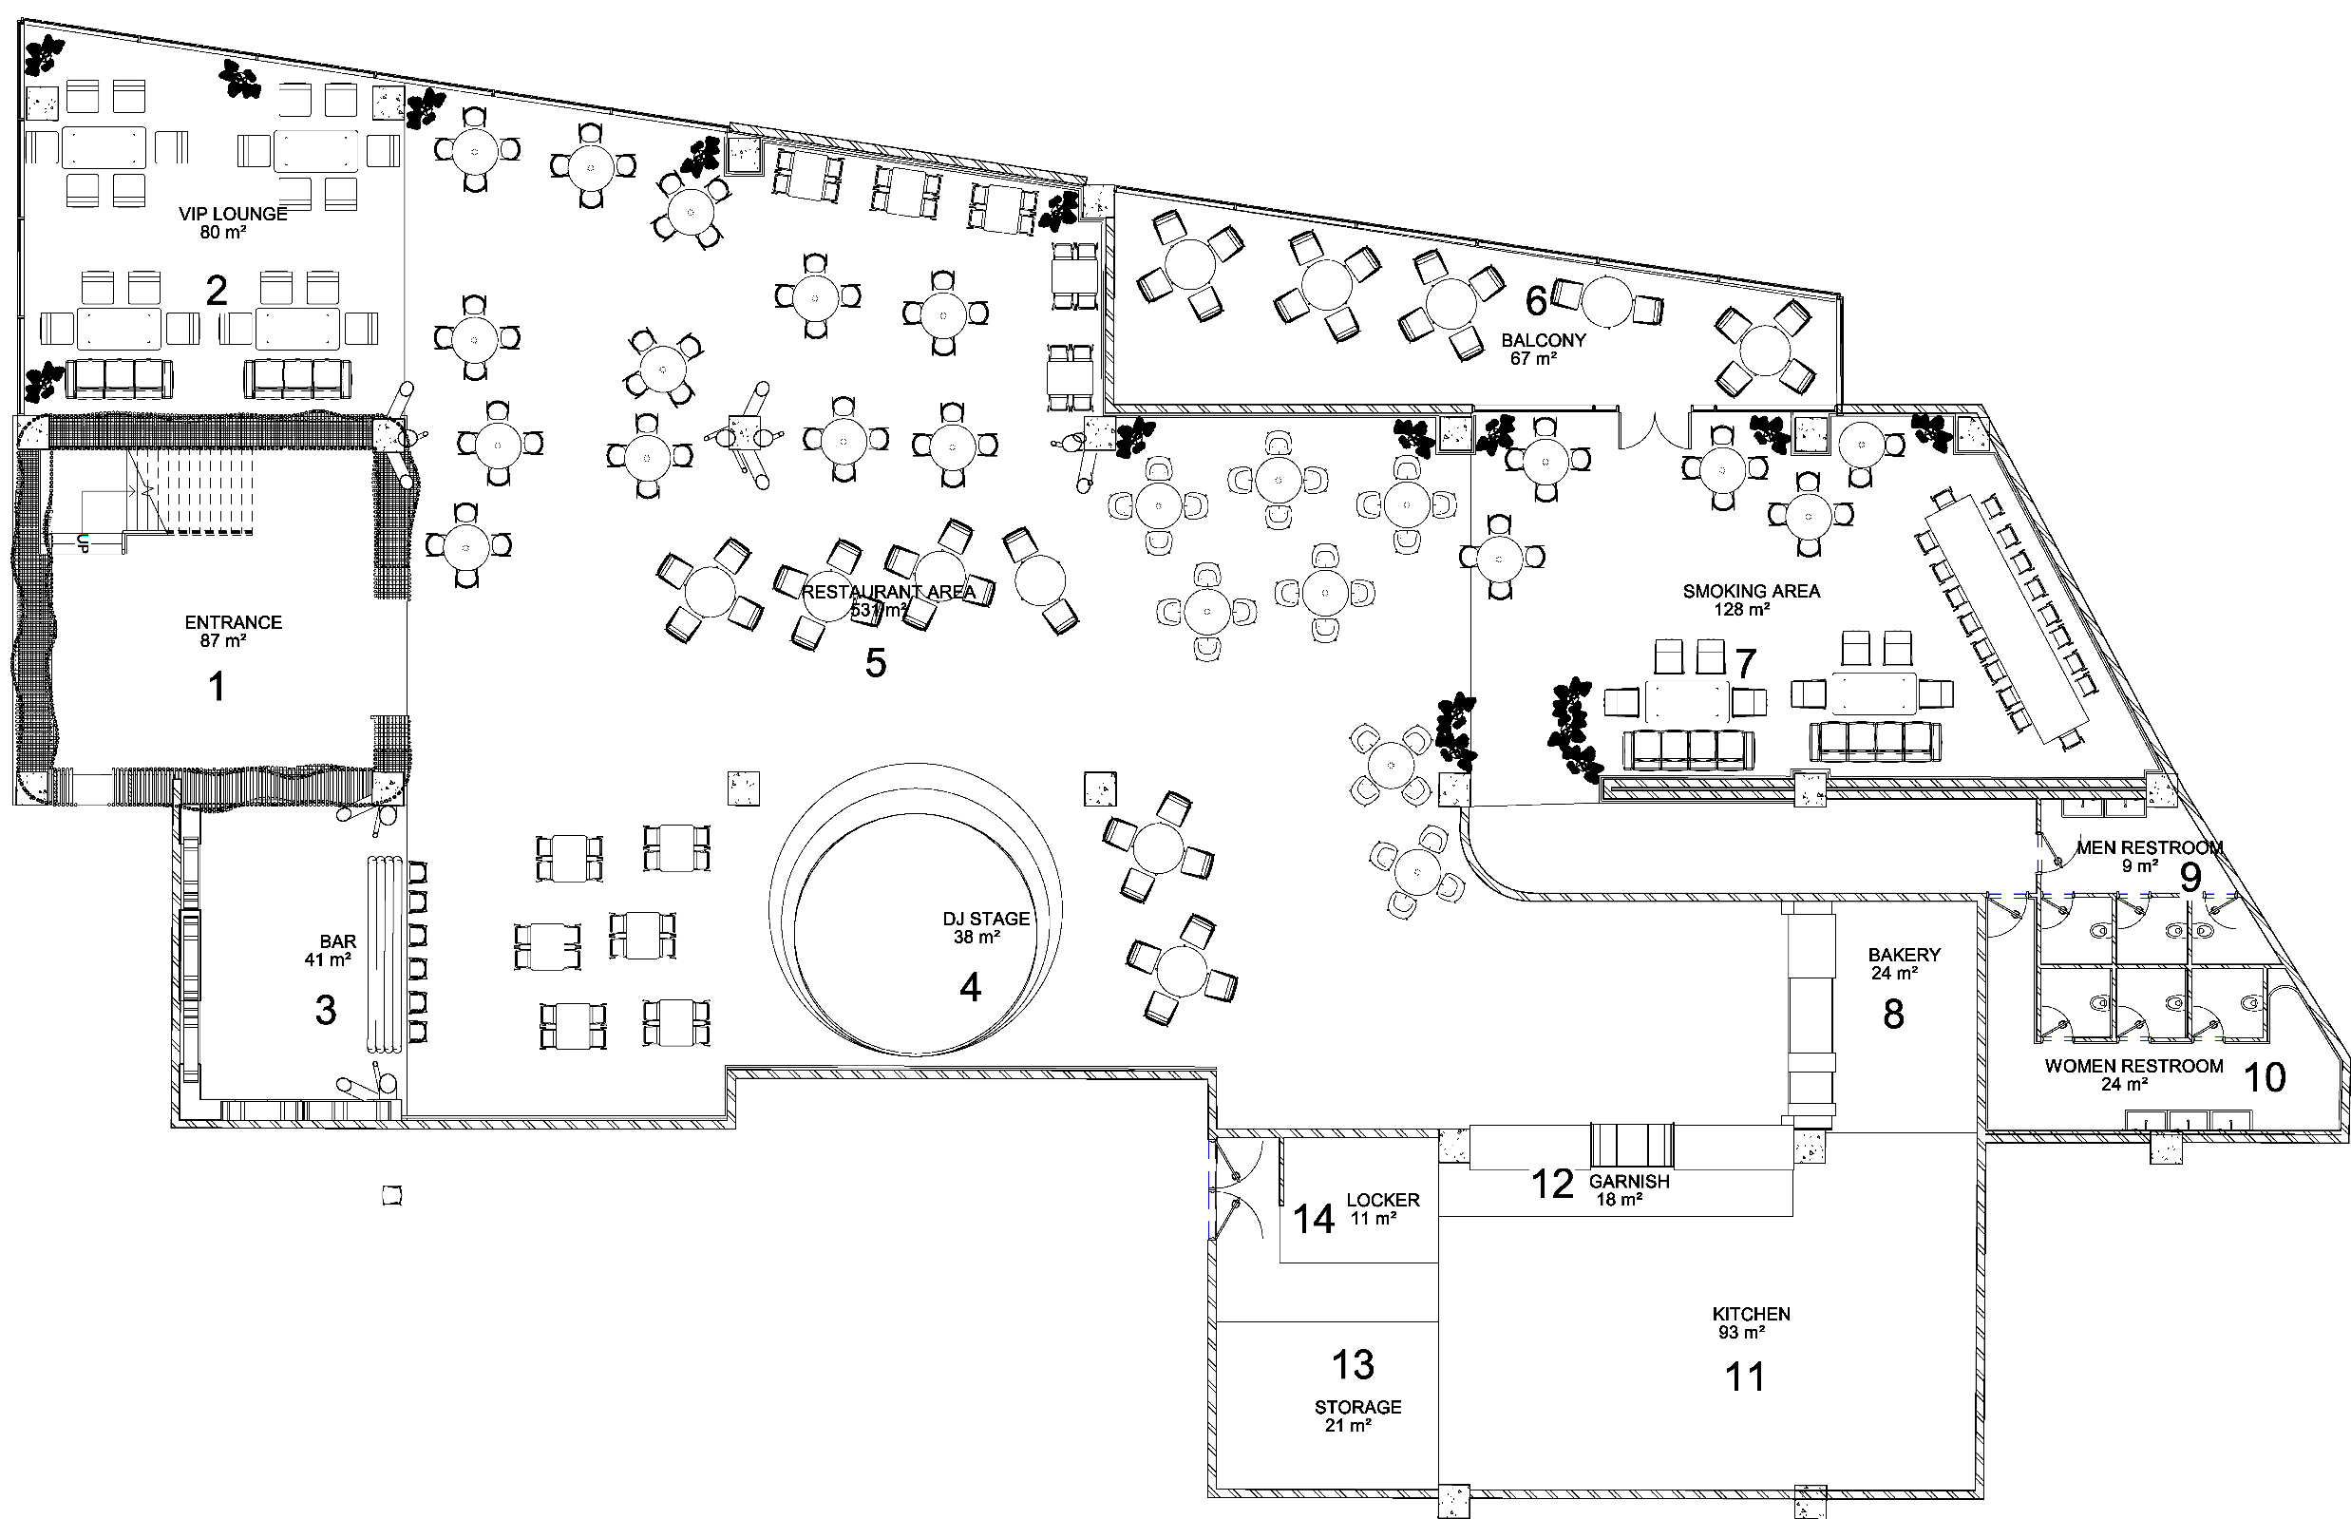
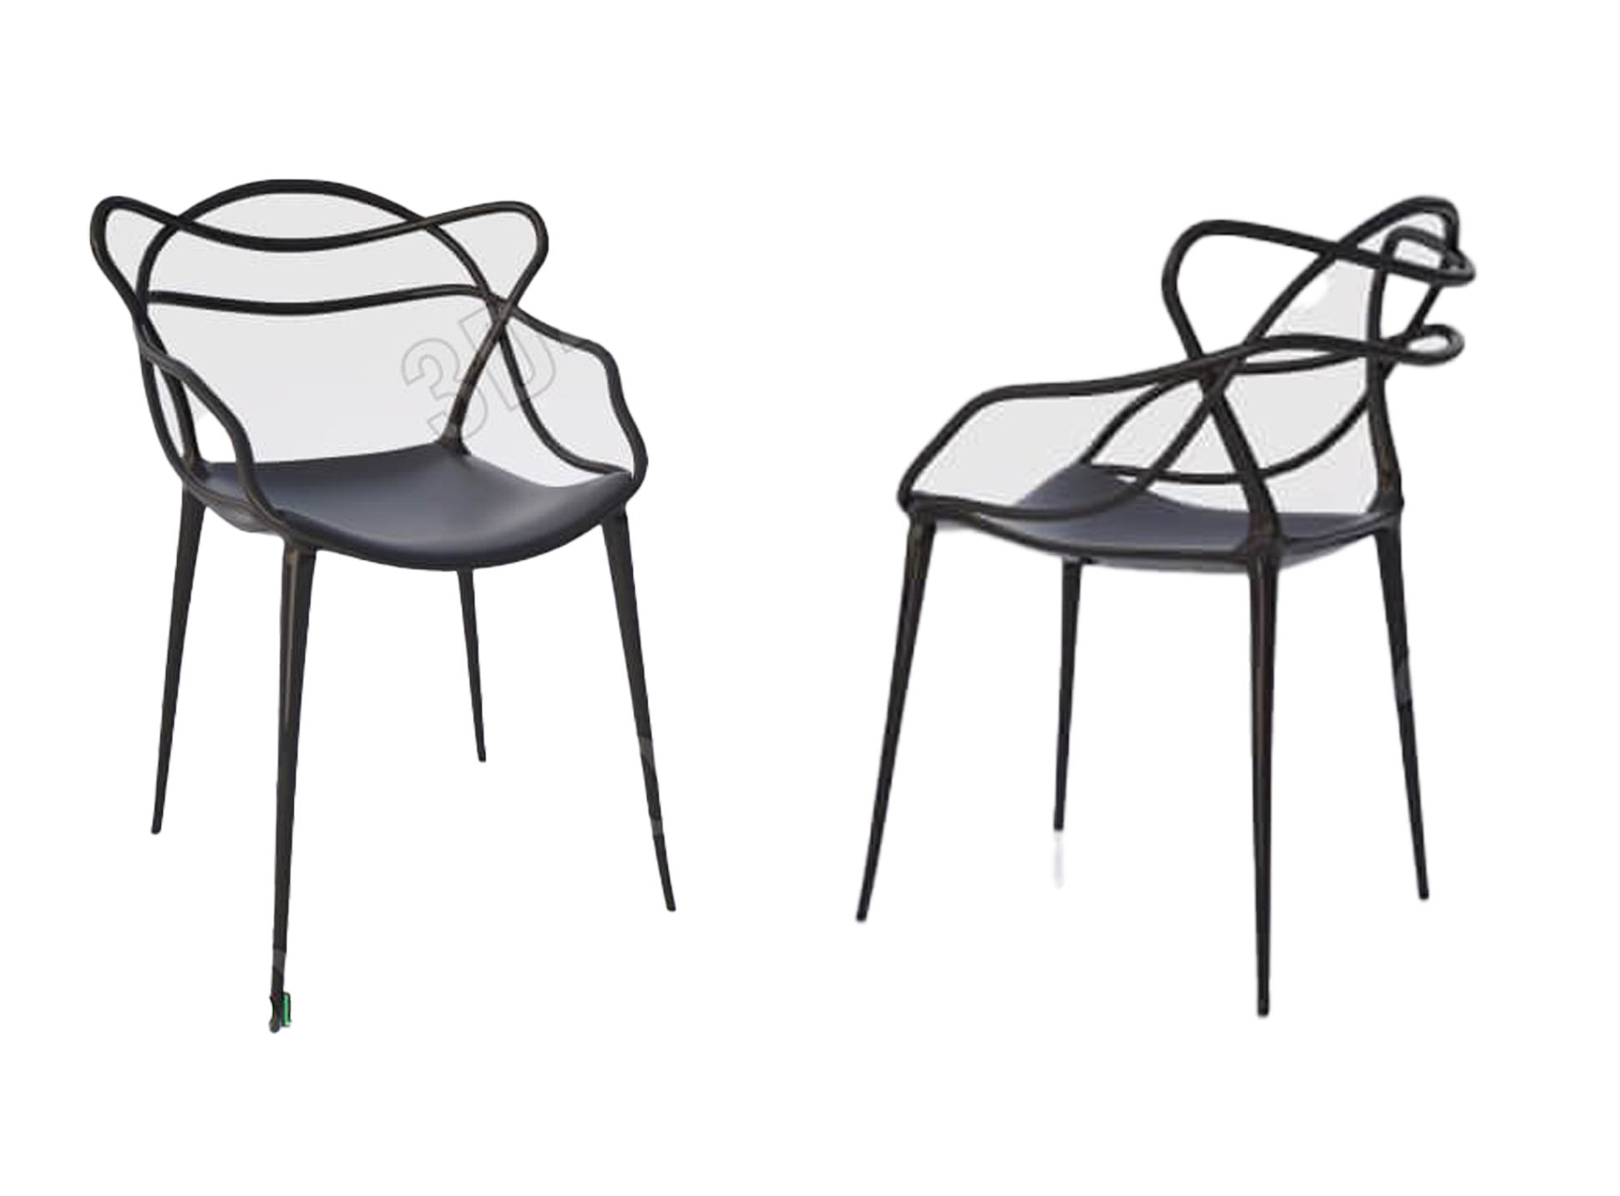
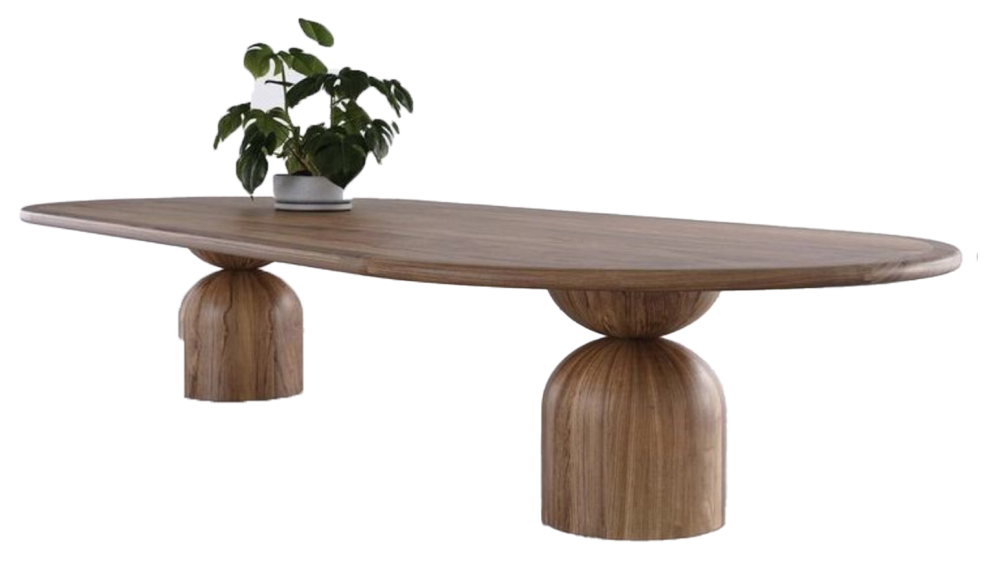
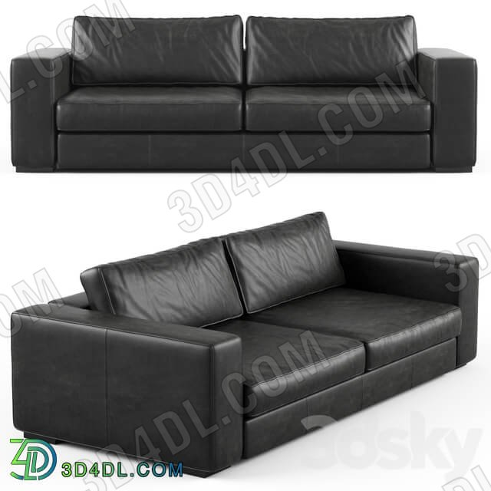
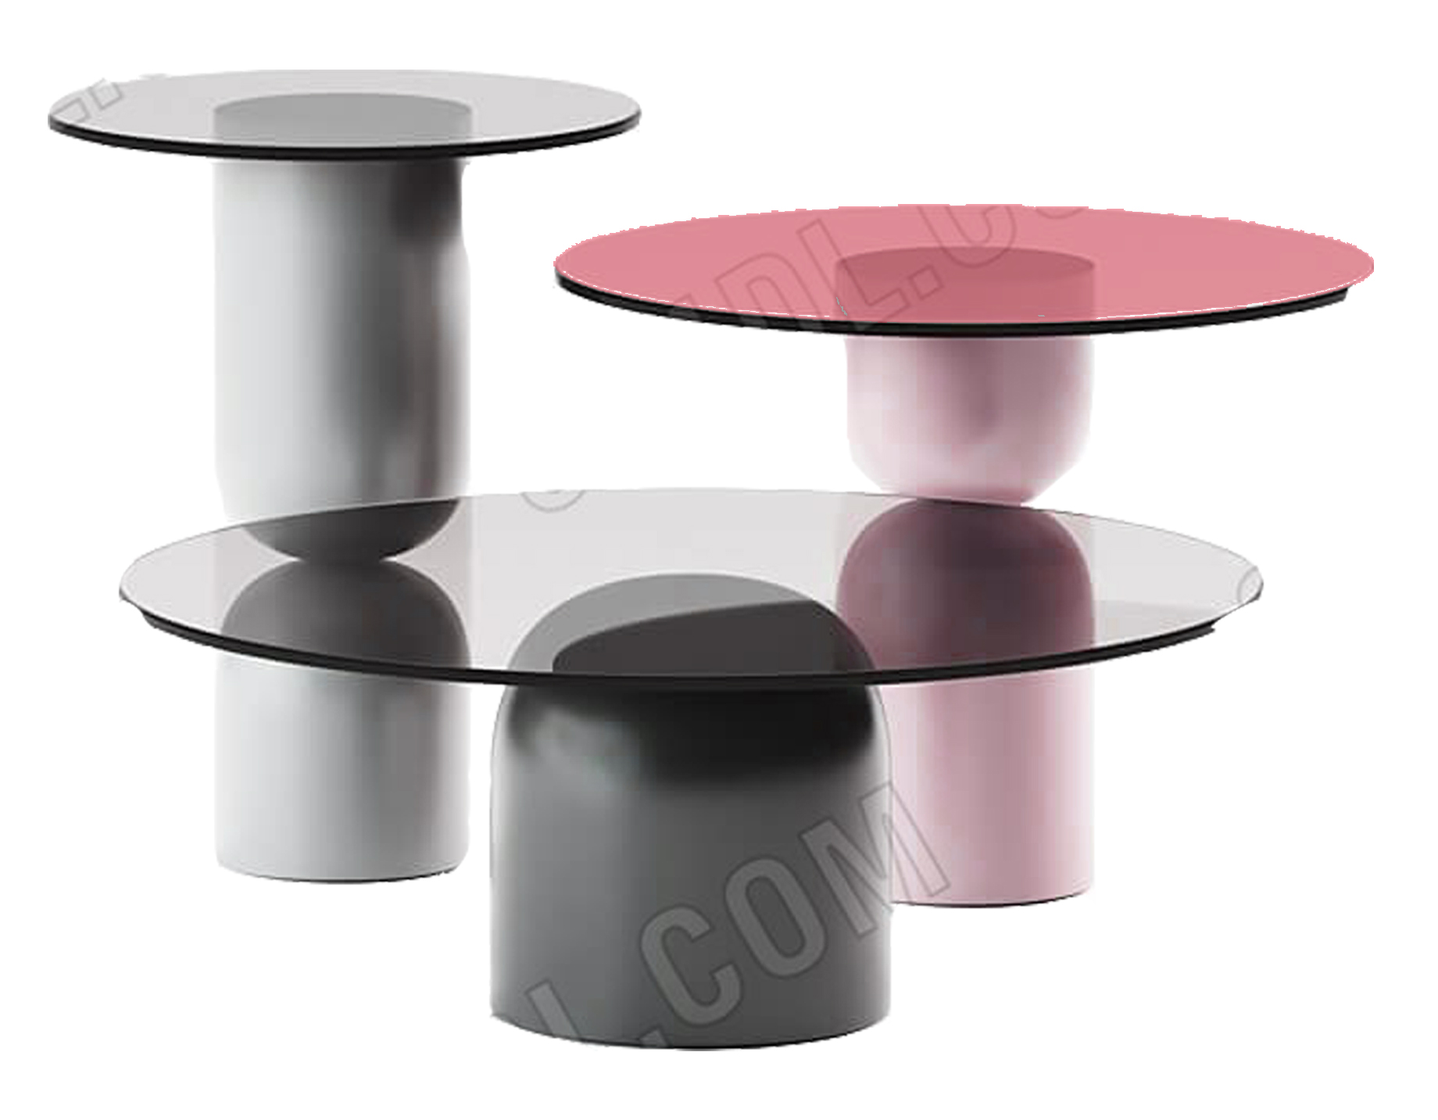
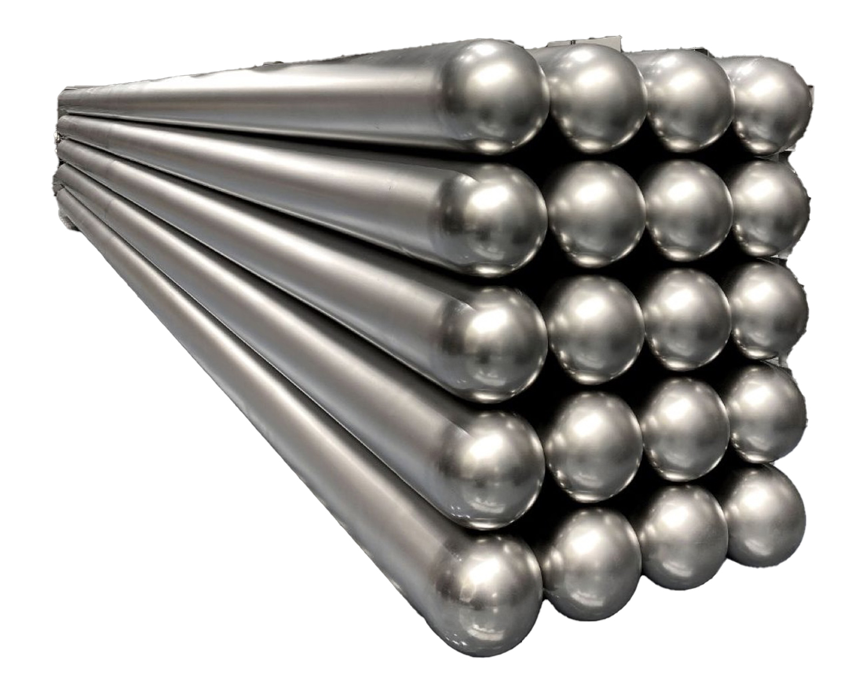
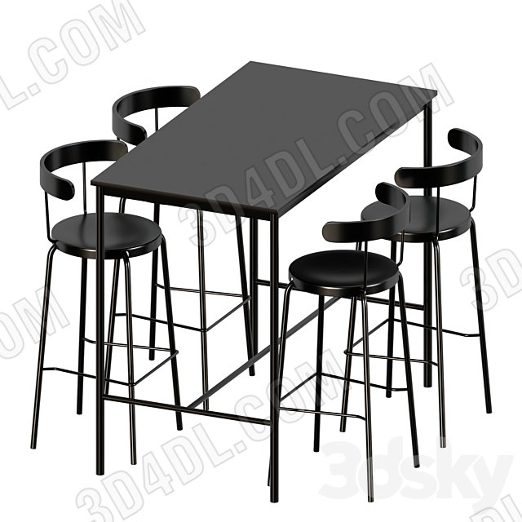
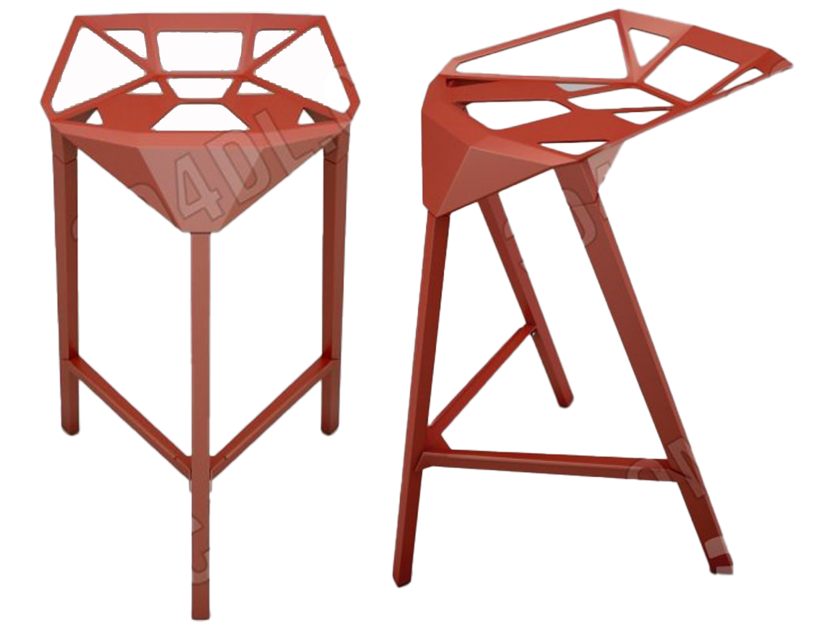
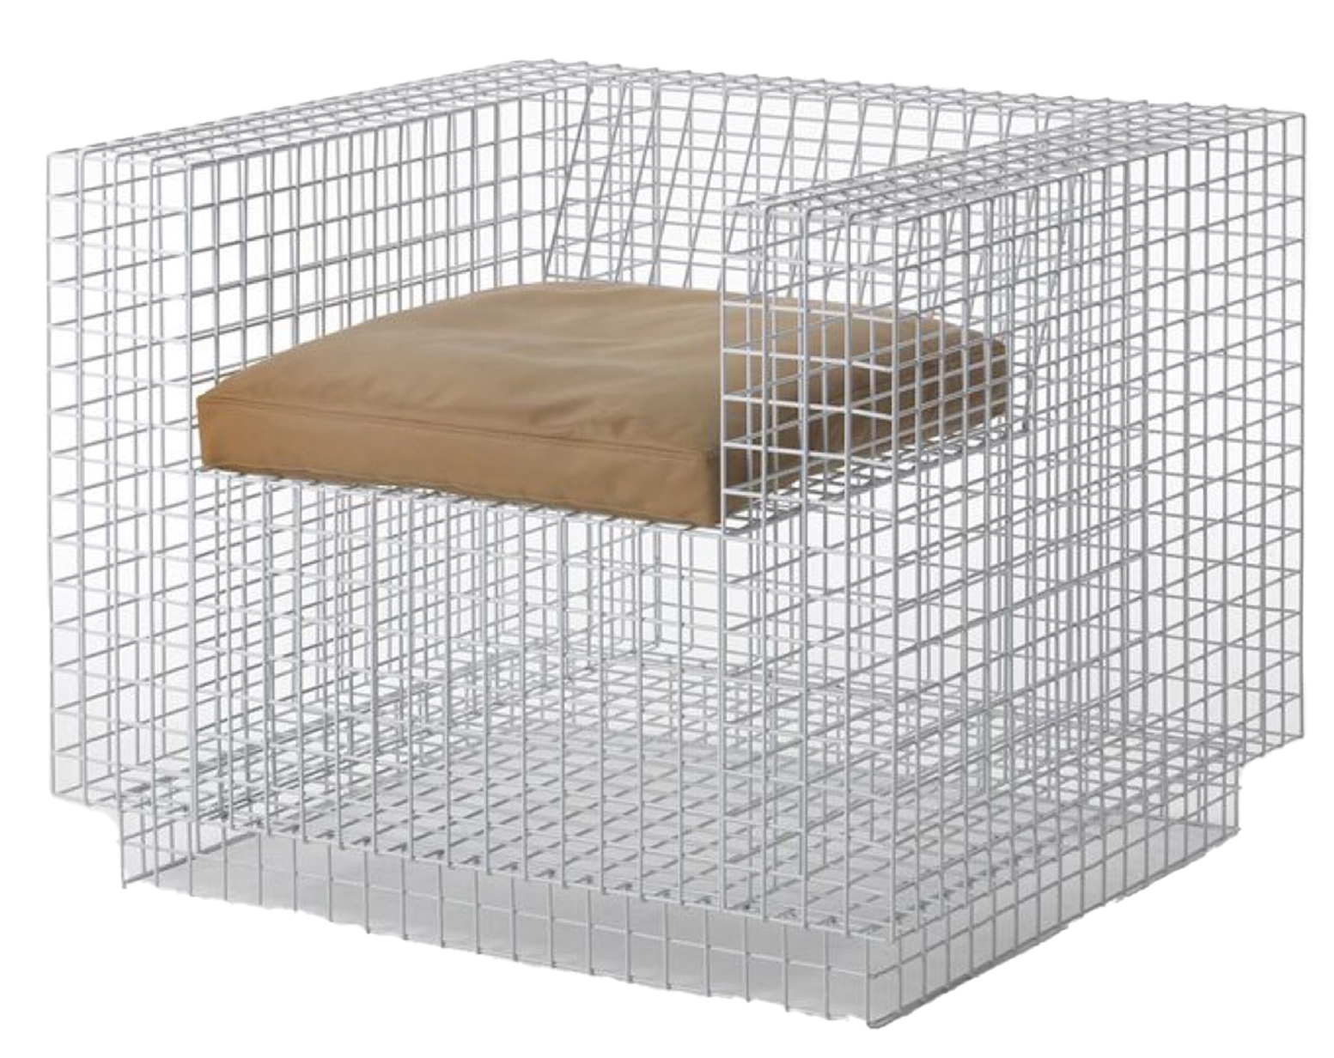
FURNITURE

Slide 34
FURNITURE LIST
NO. | MODEL AND DIMENTION | NUMBER OF SEAT | TOTAL SAET | COLOR | MATERIAL
1 |  | 1 | 40 | CREAM | COVER: FABRIC
 |  |  |  |  | INTERNAT PADDING: FOAM
 |  |  |  |  | FRAME: METAL
2 |  | 1 | 28 | BLACK | COVER : LEATHER
 |  |  |  |  | INTERNAT PADDING: FOAM
 |  |  |  |  | FRAME: METAL
3 |  | 1 | 84 | BLACK METAL | COVER : METAL
 |  |  |  |  | INTERNAT PADDING: METAL
 |  |  |  |  | FRAME: METAL

Slide 35
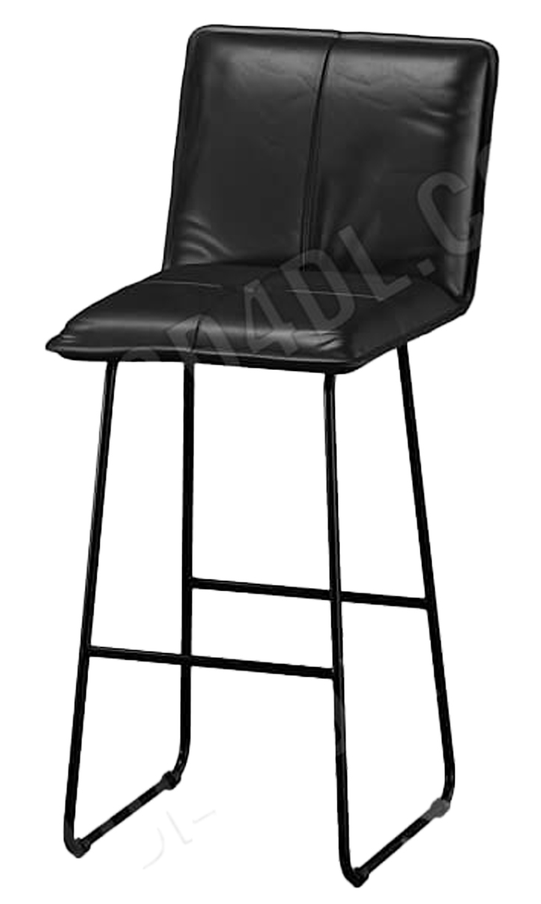
FURNITURE LIST
NO. | MODEL AND DIMENTION | NUMBER OF SEAT | TOTAL SAET | COLOR | MATERIAL
4 |  | 1 | 40 | BLACK AND CREAM | COVER: FABRIC
 |  |  |  |  | INTERNAT PADDING: FOAM
 |  |  |  |  | FRAME: METAL
5 |  | 1 | 5 | RED | COVER : METAL
 |  |  |  |  | INTERNAT PADDING: METAL
 |  |  |  |  | FRAME: METAL
6 |  | 1 | 62 | BLACK | COVER : LEATHER
 |  |  |  |  | INTERNAT PADDING: FOAM
 |  |  |  |  | FRAME: METAL

Slide 36
FURNITURE LIST
NO. | MODEL AND DIMENTION | NUMBER OF SEAT | TOTAL SAET | COLOR | MATERIAL
7 |  | 3 | 6 | BLACK | COVER: LEATHER
 |  |  |  |  | INTERNAT PADDING: FOAM
 |  |  |  |  | FRAME: PLYWOOD
8 |  | 4 | 8 | RED | COVER : FABRIC
 |  |  |  |  | INTERNAT PADDING: FOAM
 |  |  |  |  | FRAME: PLYWOOD
9 |  | S: 36 | 53 | BLACK AND RED | GLASS AND METAL
 |  | M: 11
 |  | L: 6

Slide 37
FURNITURE LIST
NO. | MODEL AND DIMENTION | NUMBER OF SEAT | TOTAL SAET | COLOR | MATERIAL
10 |  |  | 11 | BLACK | METAL
11 |  | 1 | 1 | CHROME | METAL
12 |  | 1 | 1 | WOOD | WOOD

Slide 38
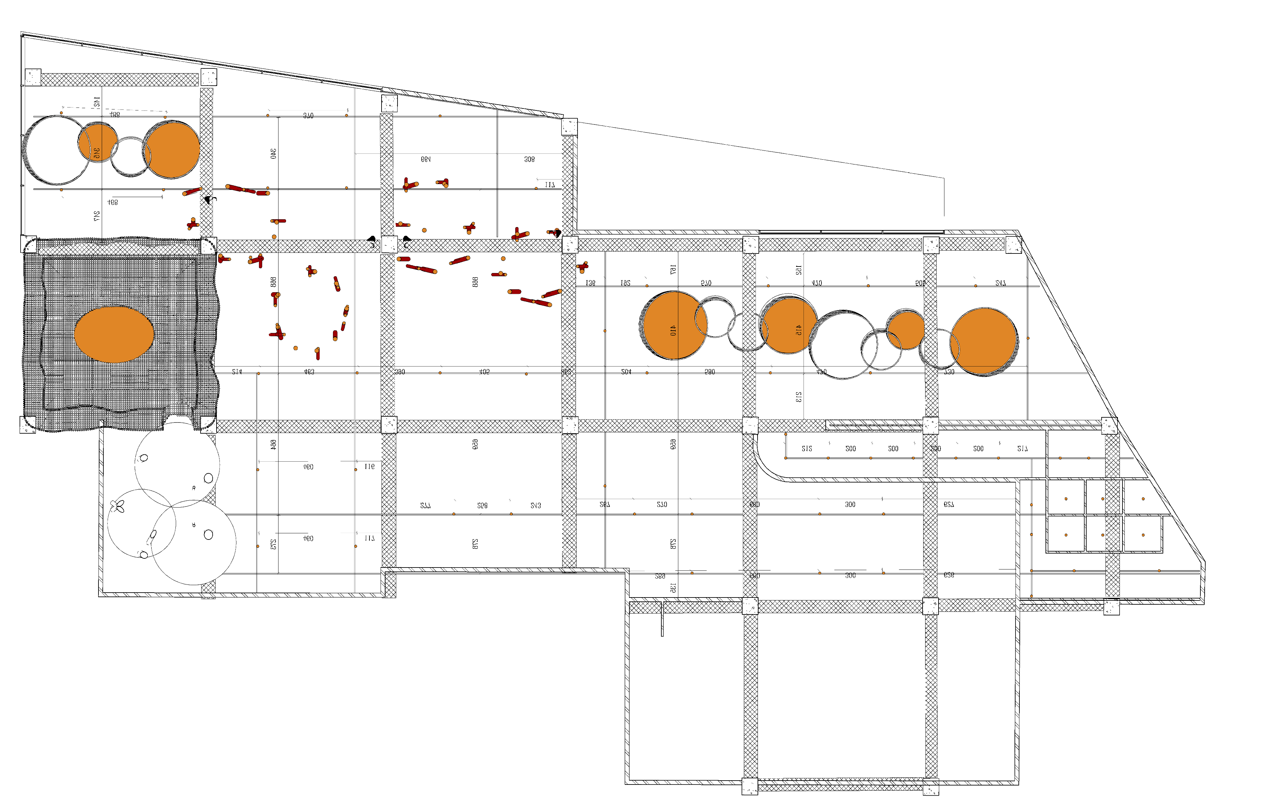
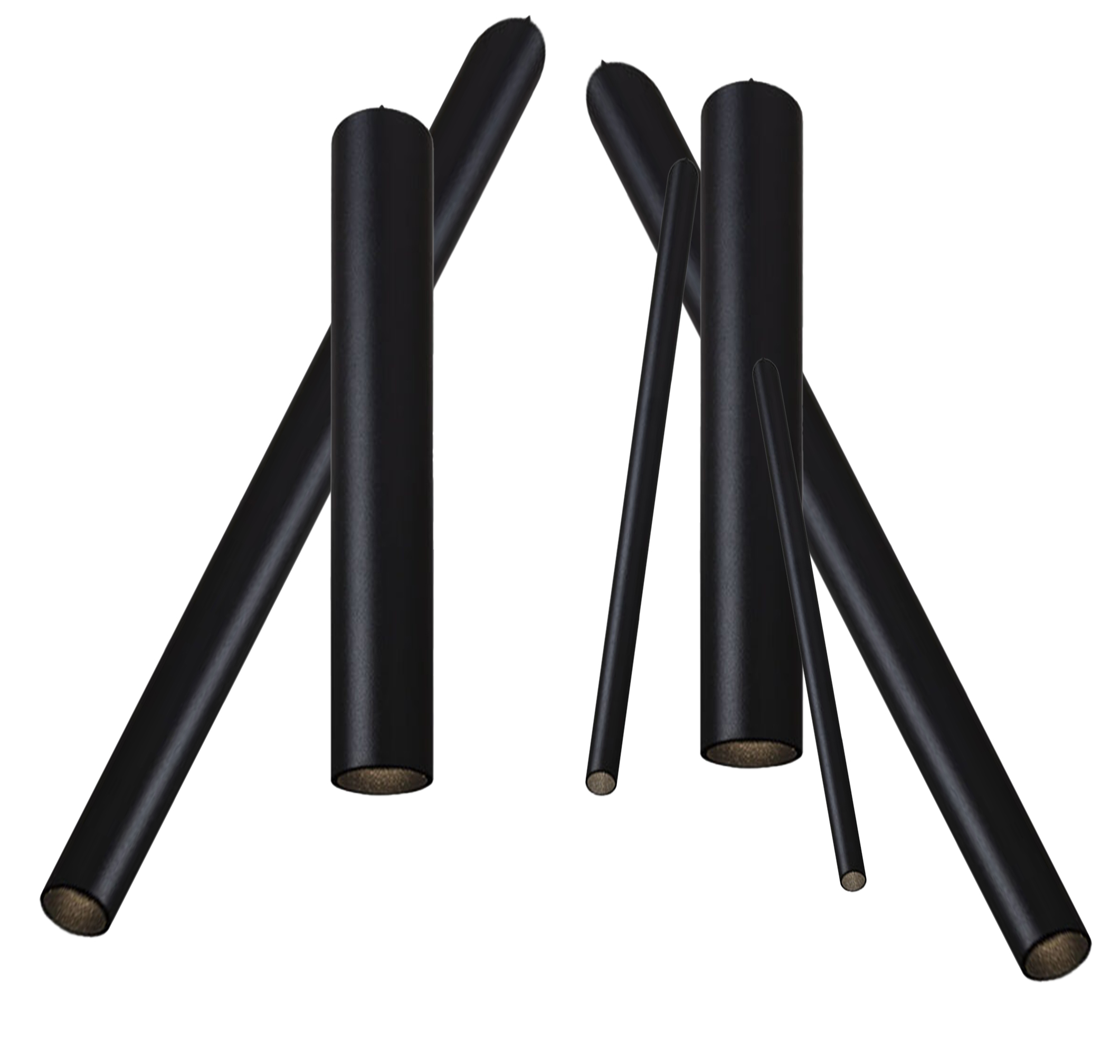
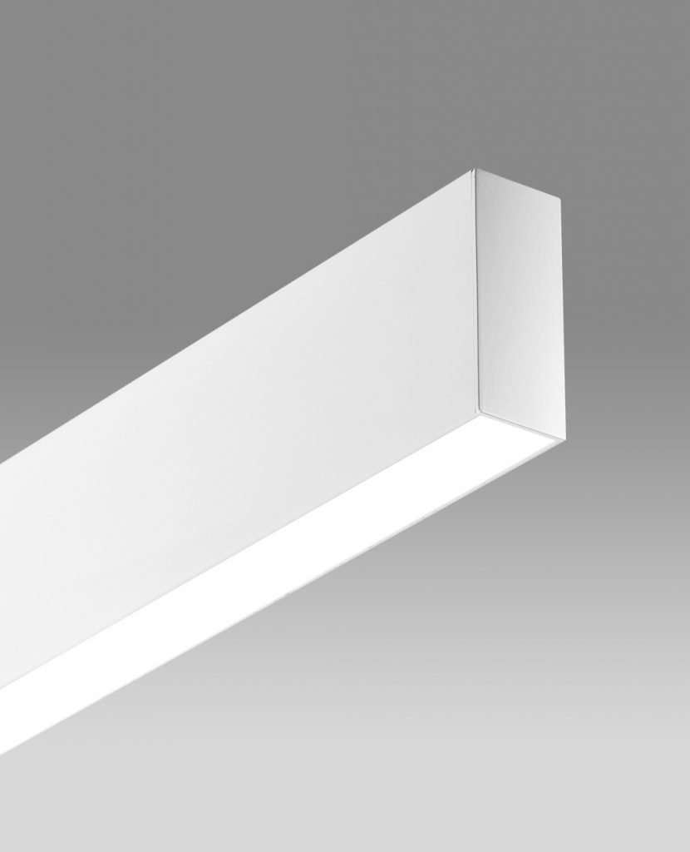
LIGHTING PLAN
4
1
2
1
2
1
4
3
3
4
1 GENERAL LIGHTING
2 SPOTLIGHT
3 DOWNLIGHT
N
4 LINEAR LIGHTING

Slide 39
GENERAL LIGHTING

Slide 40
LIGHTING PLAN
4
1
2
1
2
1
4
3
3
4
1 GENERAL LIGHTING
2 SPOTLIGHT
3 DOWNLIGHT
N
4 LINEAR LIGHTING

Slide 41
DOWN LIGHT

Slide 42
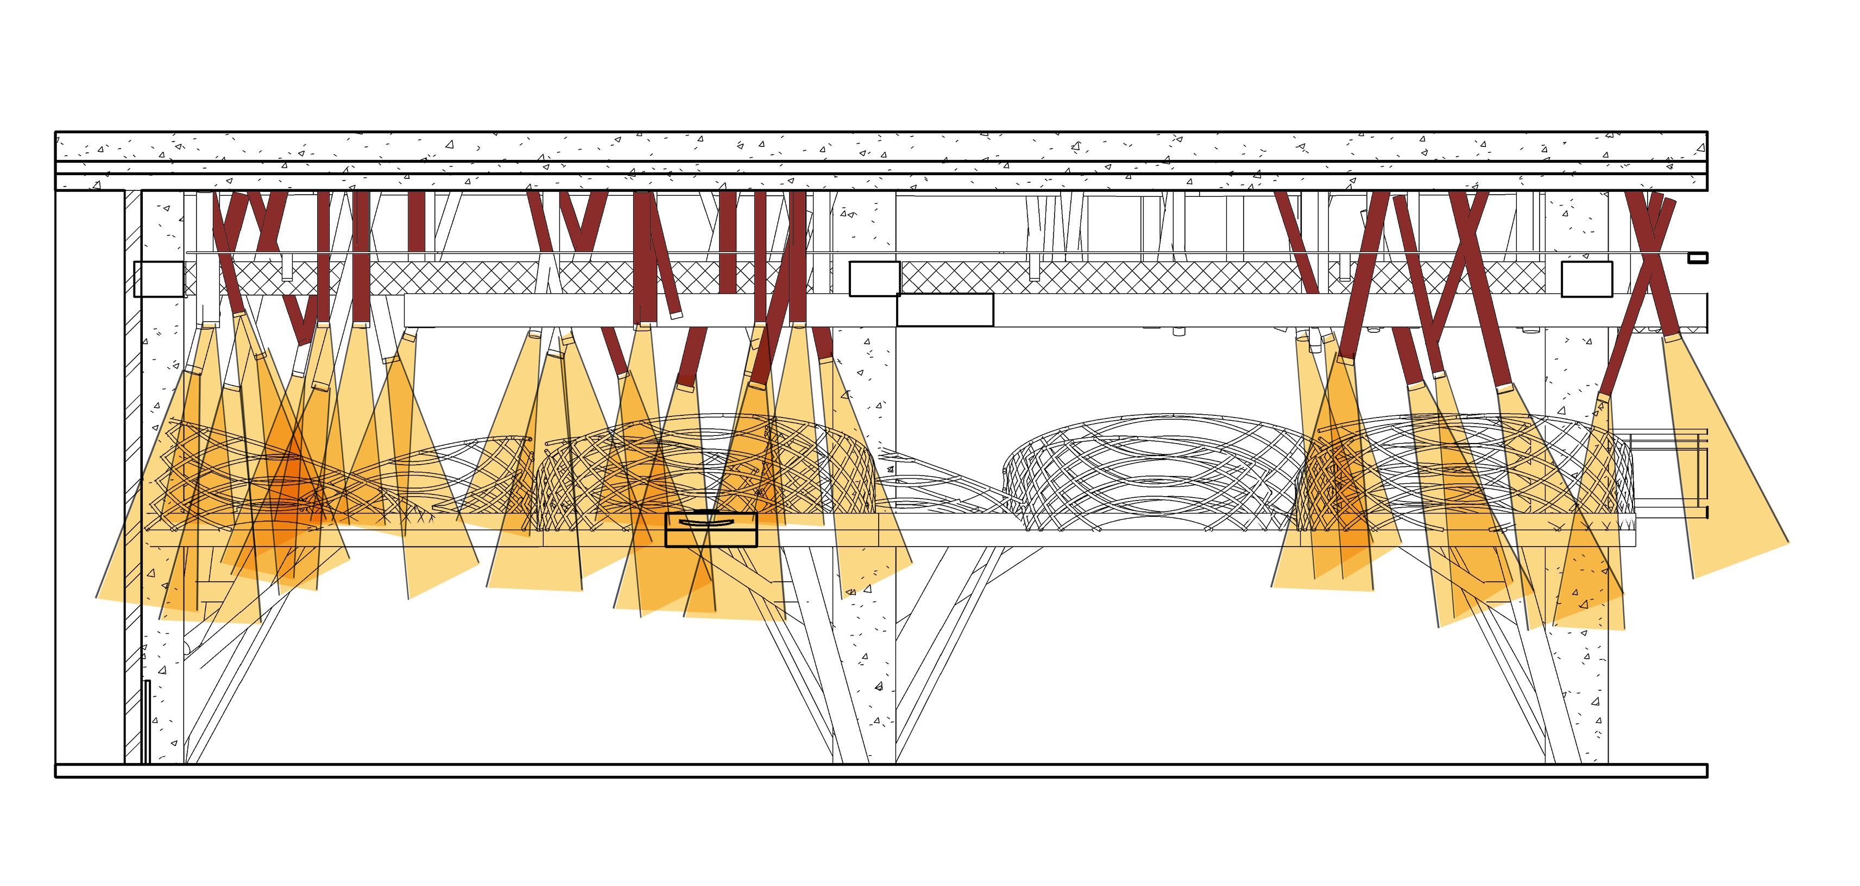
SPOTLIGHT

Slide 43
LINEAR LIGHTING

Slide 44
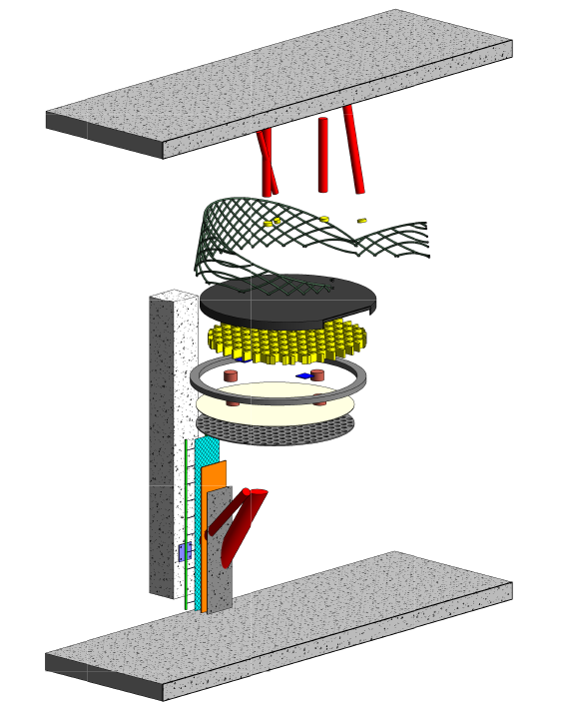
MEZZANINE LAYOUT
SPOT LIGHT
RAILING
IRON SHEET
STRUCTURAL COLUMN
PROFIL
LIGHTING
PLATE
DIFFUSER
PROFIL
PUNCH METAL
REBAR
WIRE LATH
CEMENT
MANISMAN PIPE
FINISH LAYAR MICROCEMENT
FINISH LAYAR MICROCEMENT

